Slide 1
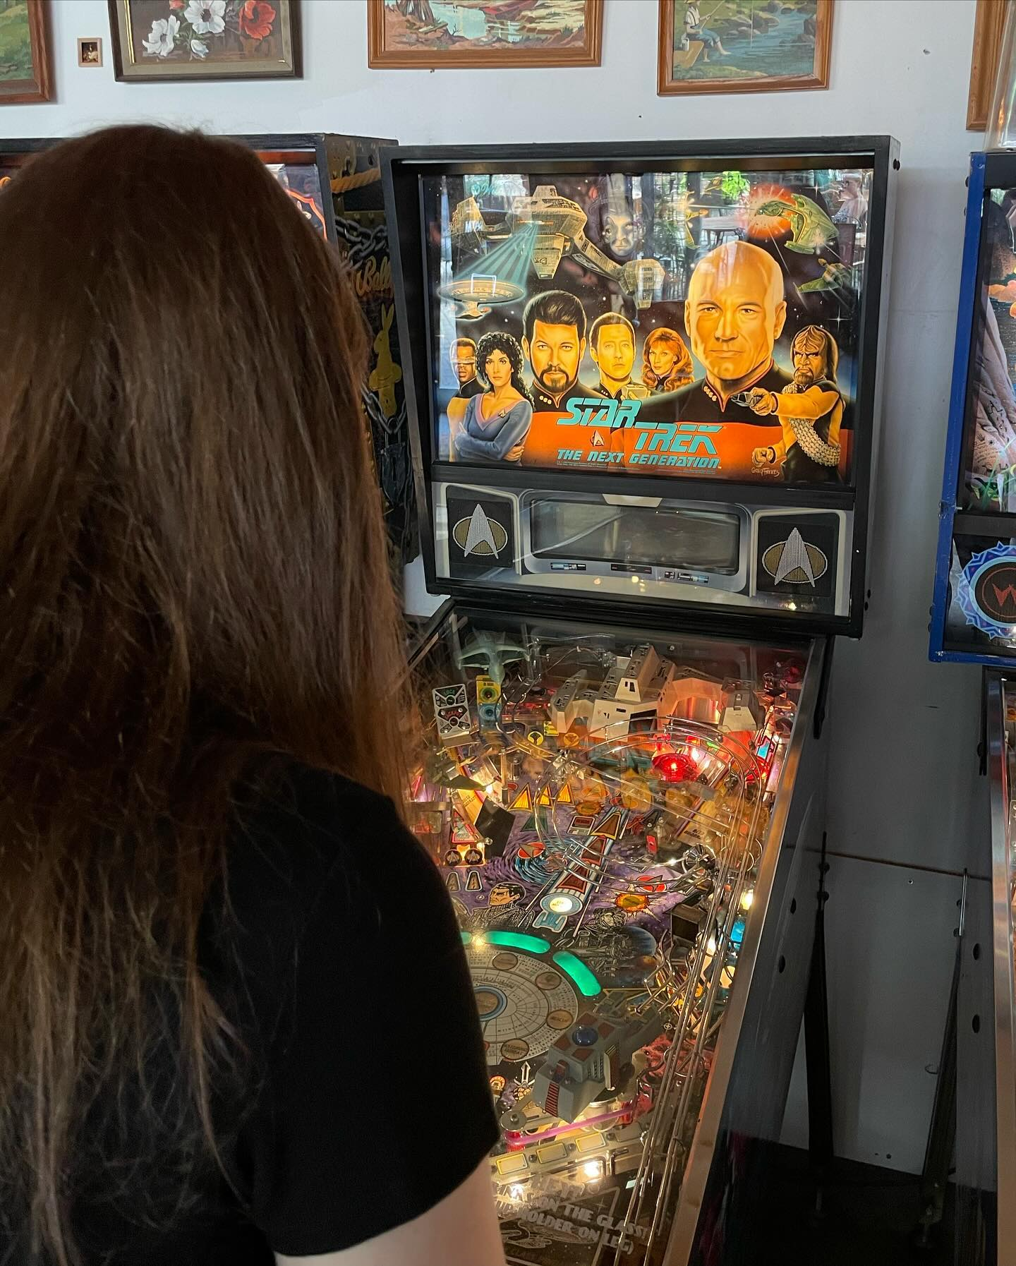
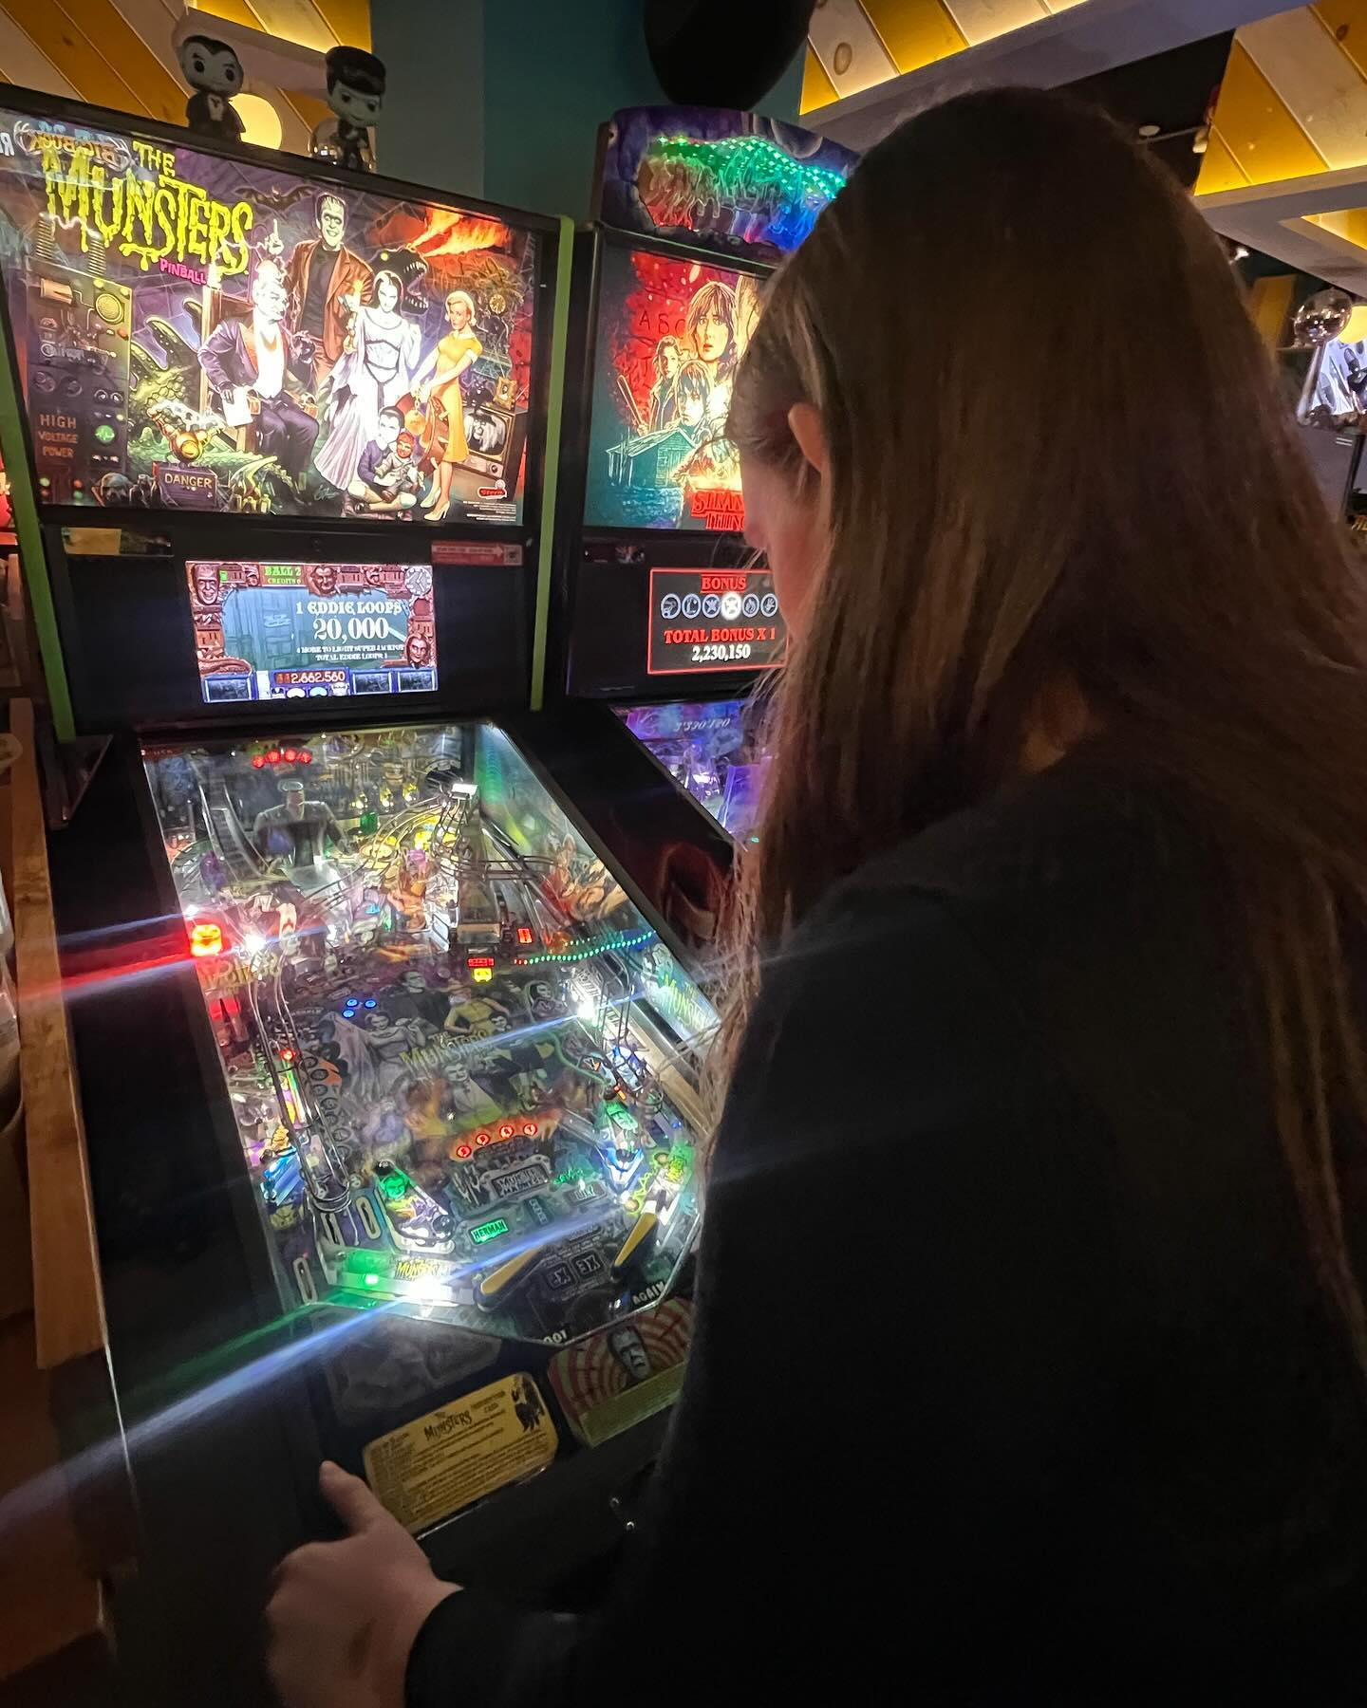
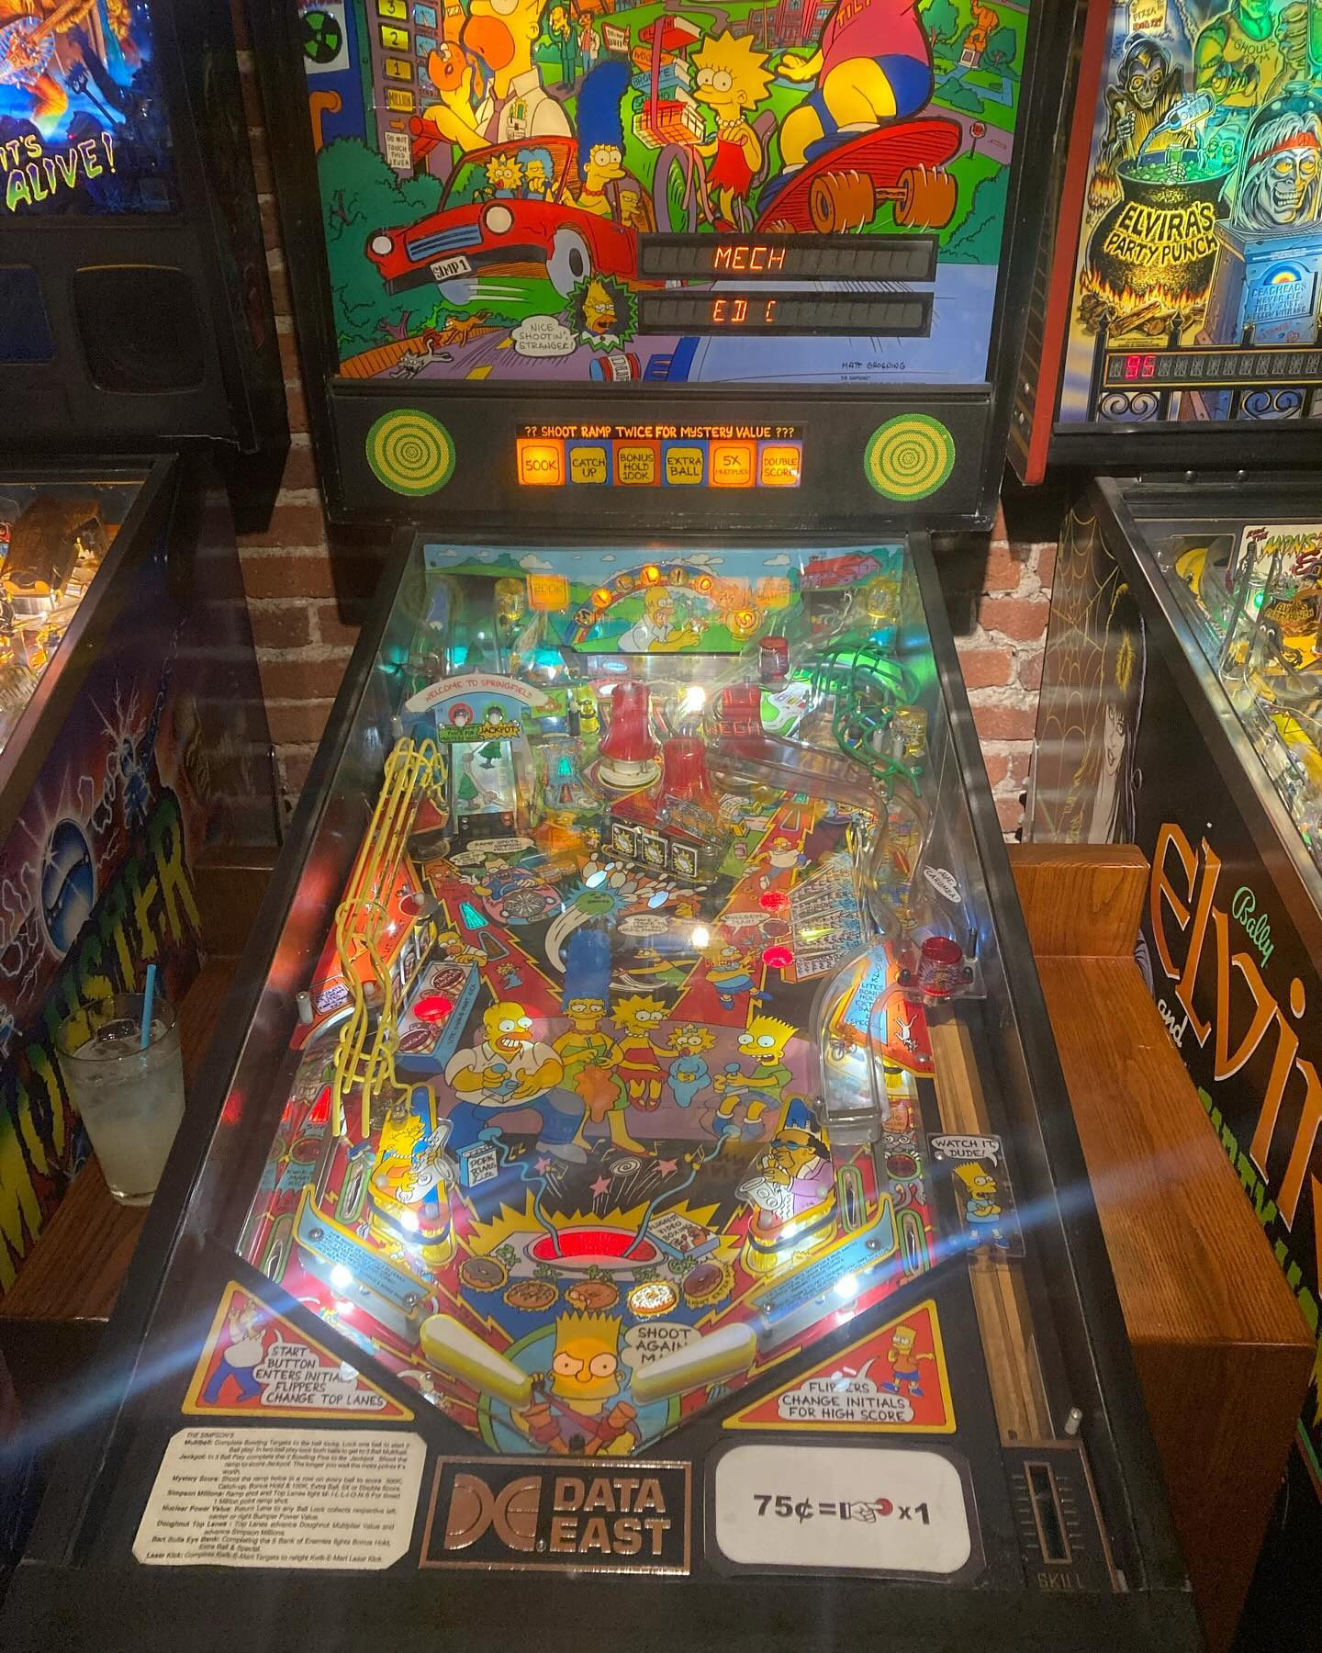
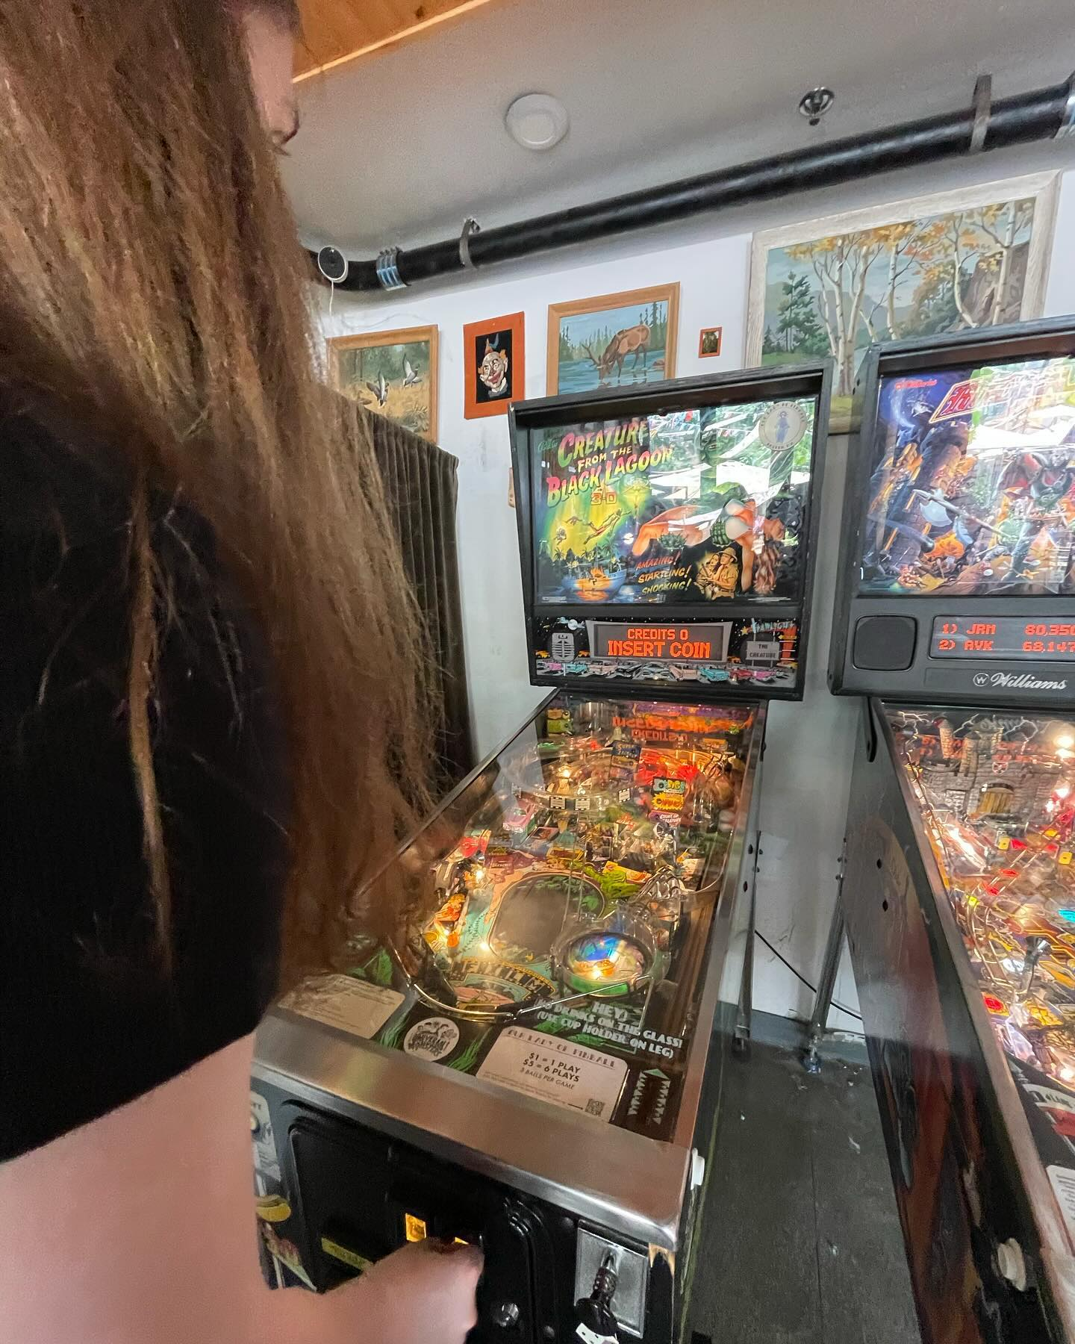
Pinball
AIFX Hobby Series
Micah Weston

Slide 2
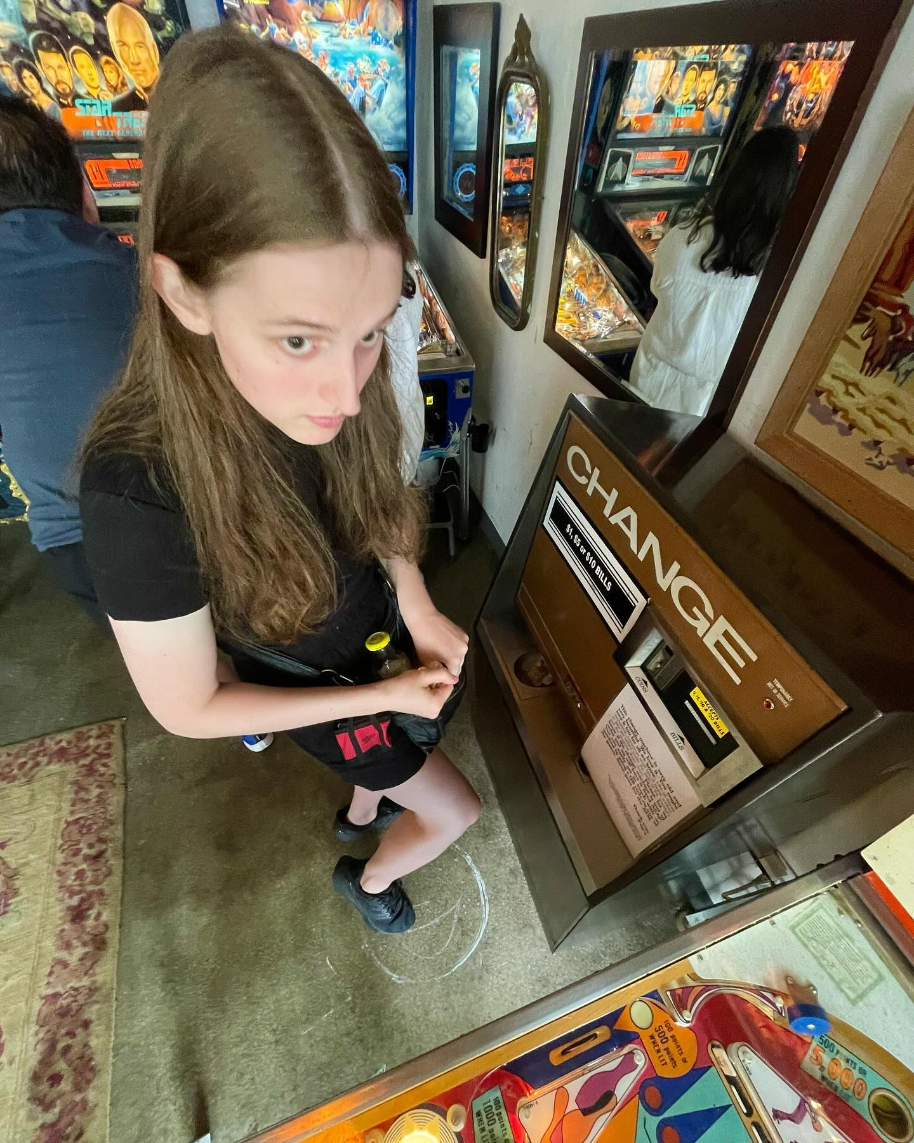
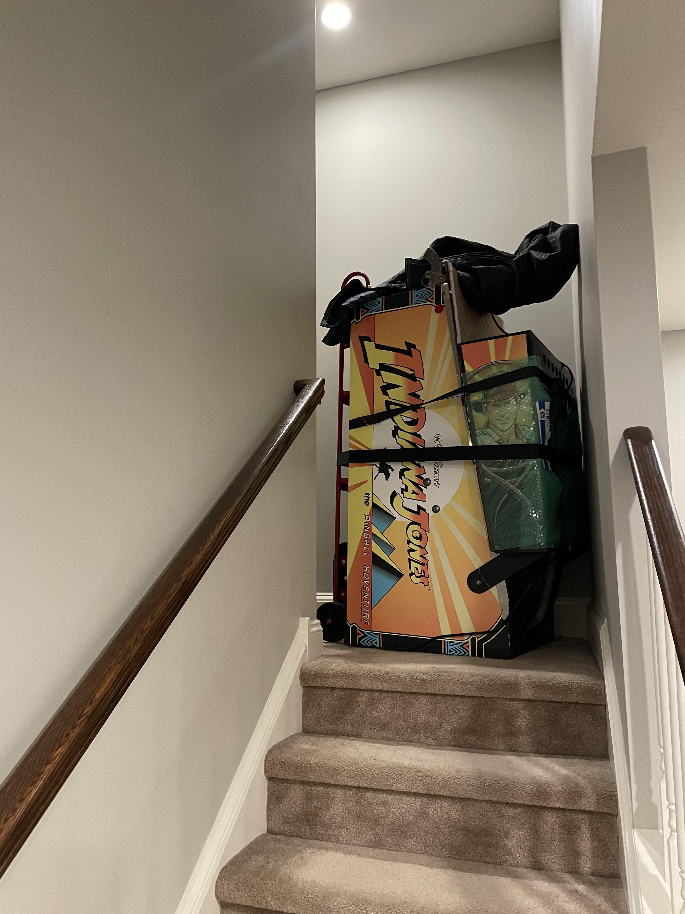
Do you want a hobby that…
… has fun games and interesting themes?
… has years of history and evolution?
… will ‘nickel’ and ‘dime’ you to death (or more accurately ‘quarter’ and ‘token equivalent of quarter’ you to death)?
… gets cheaper as you improve (kinda)?
… has a device which is totally easy to bring up and down stairs?
… will help you meet new people?

Slide 3
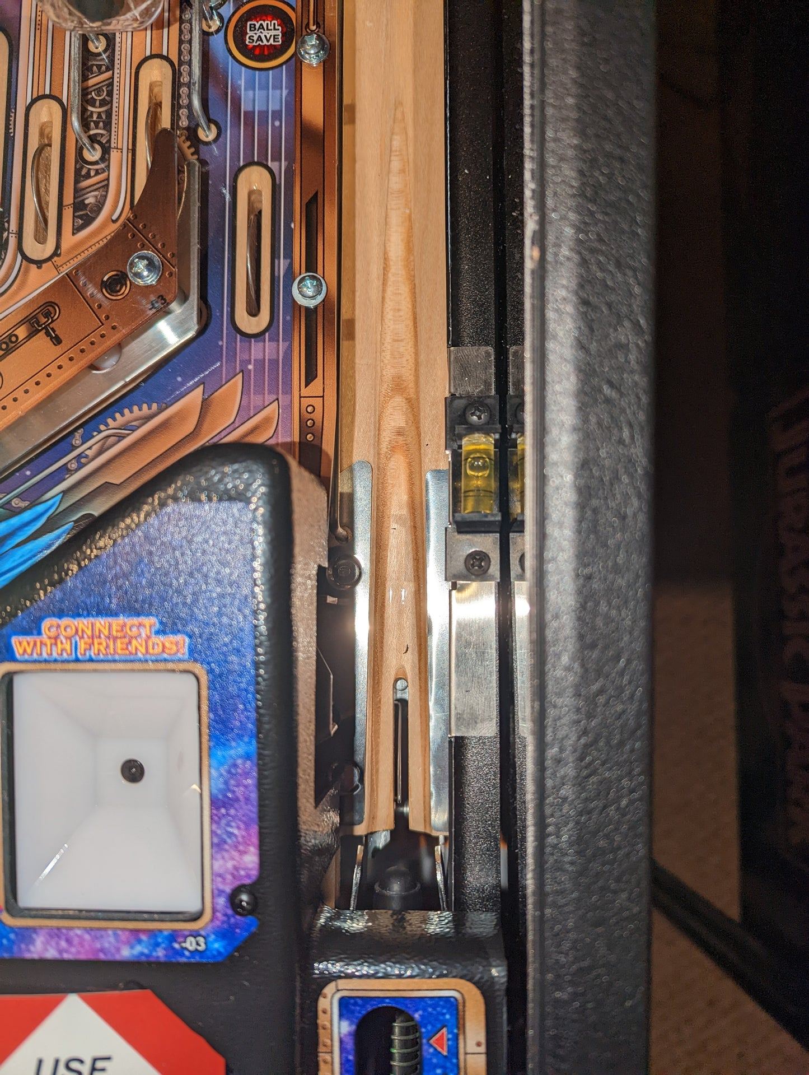
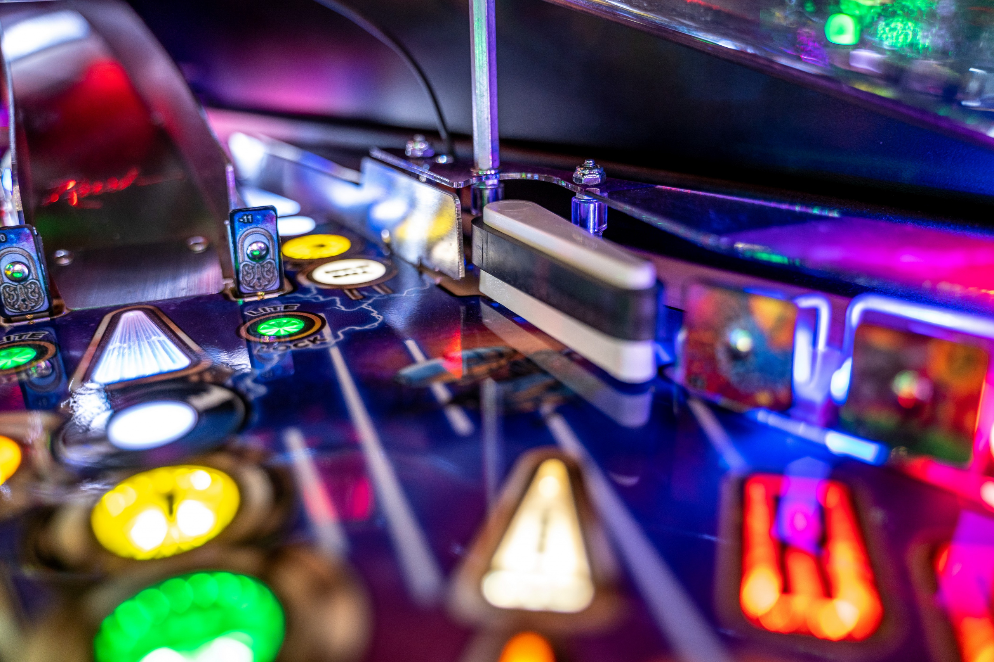
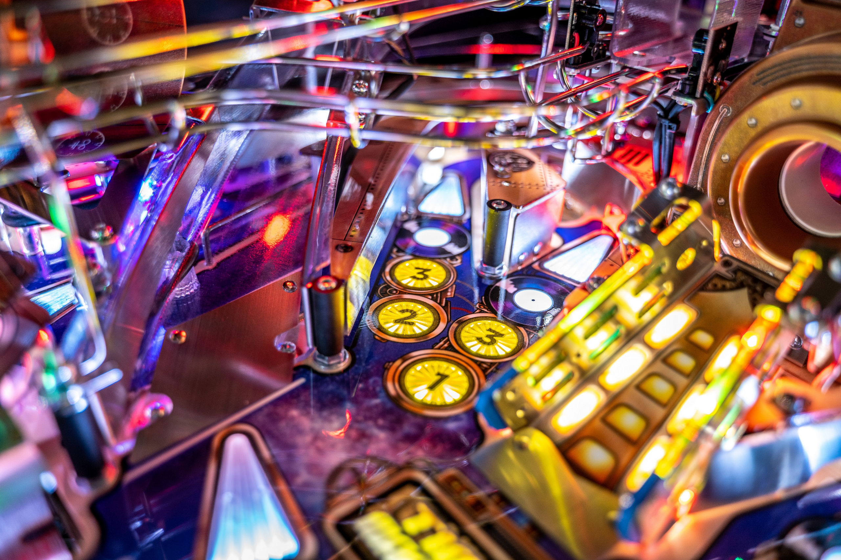
Three Step Pinball Tutorial
Start a ball using either a physical plunger or a launch button.
Use left cabinet button to flip the left flipper and right cabinet button to flip the right flipper.
Shoot the blinking lights and try not to drain.

Slide 4
Pinball and Me
From passive interest to primary hobby

Slide 5
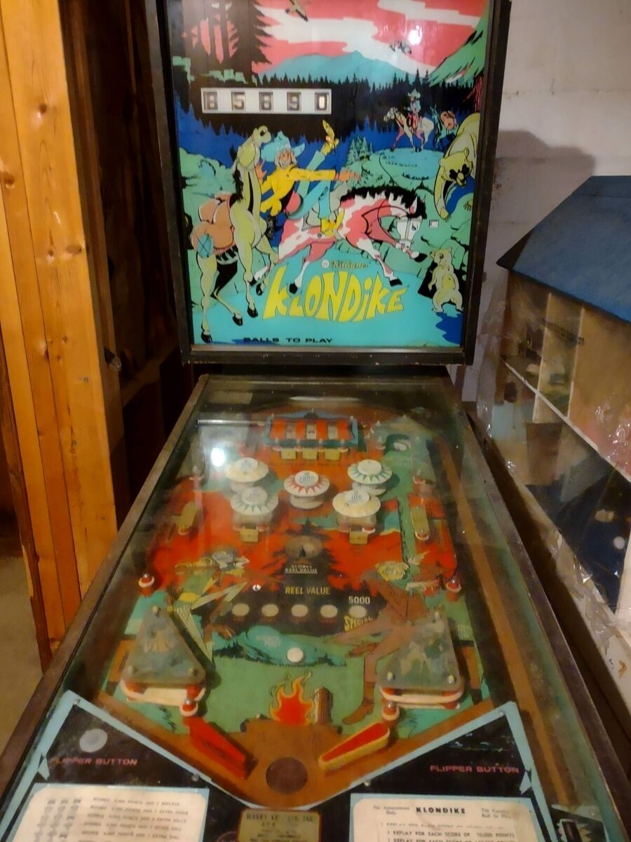
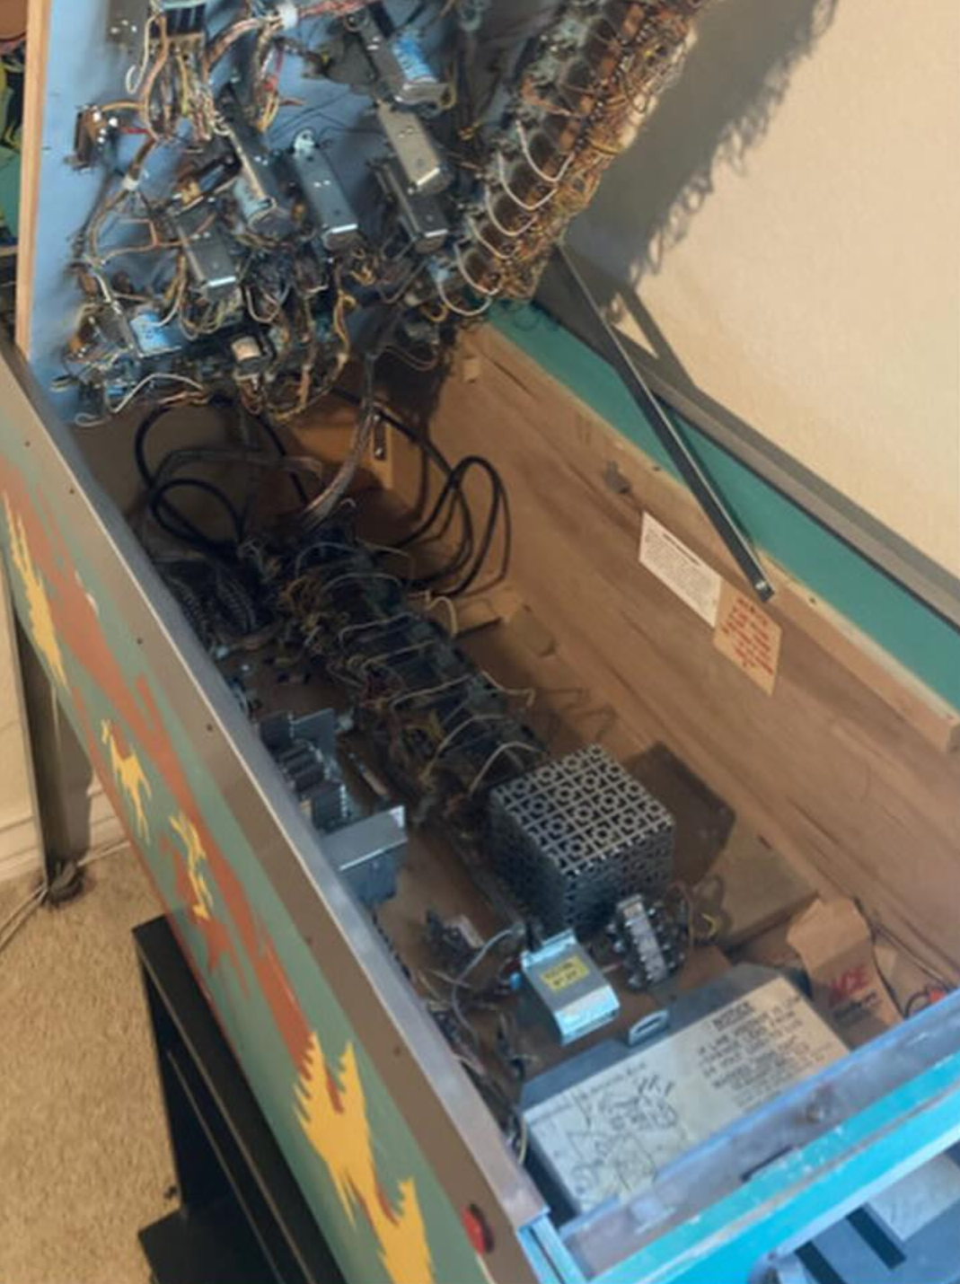
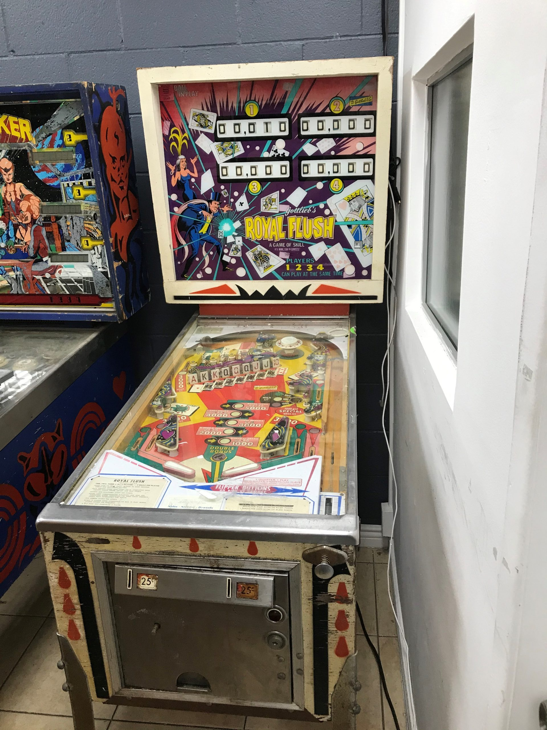
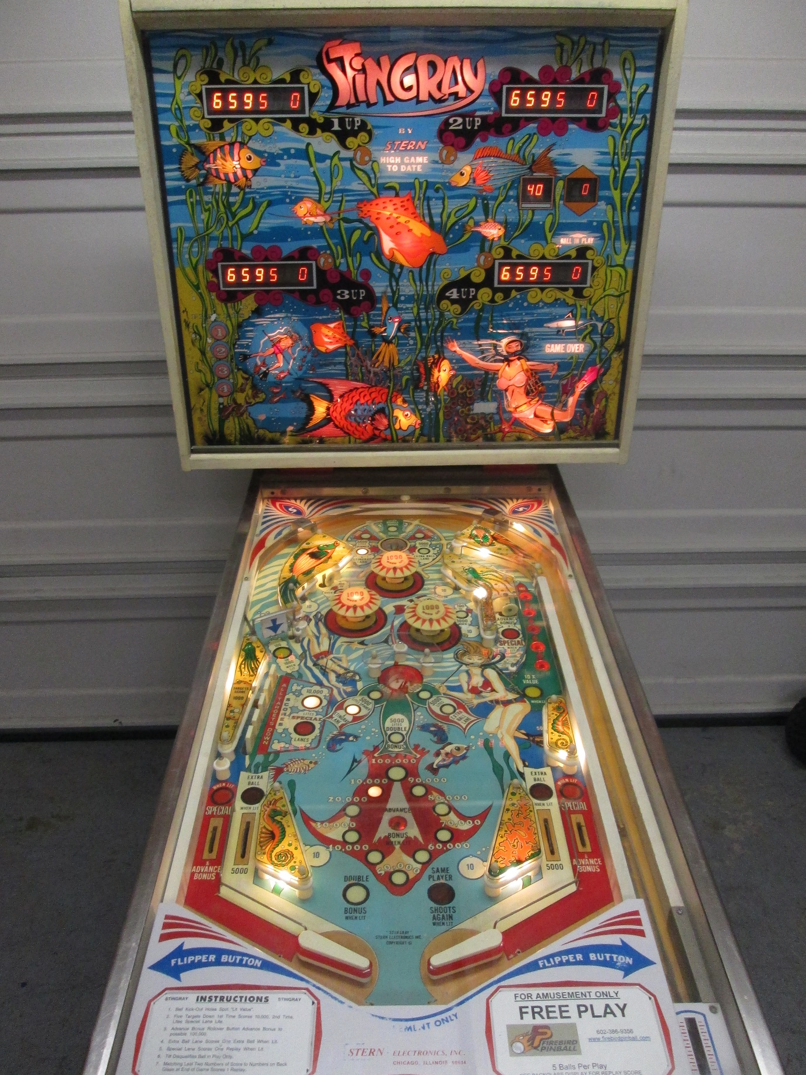
Growing Up
Born and raised in Las Vegas, Nevada.
Three pins in our house (and multiple slot machines because Vegas).
Dad collected them back when he worked for a pinball operator and then Bally.
Klondike – my dad’s favorite from his childhood.
Royal Flush – a classic poker themed pin.
Stingray – the one that lived the garage until being sold.
Did not play much since they blended into the environment.

Slide 6


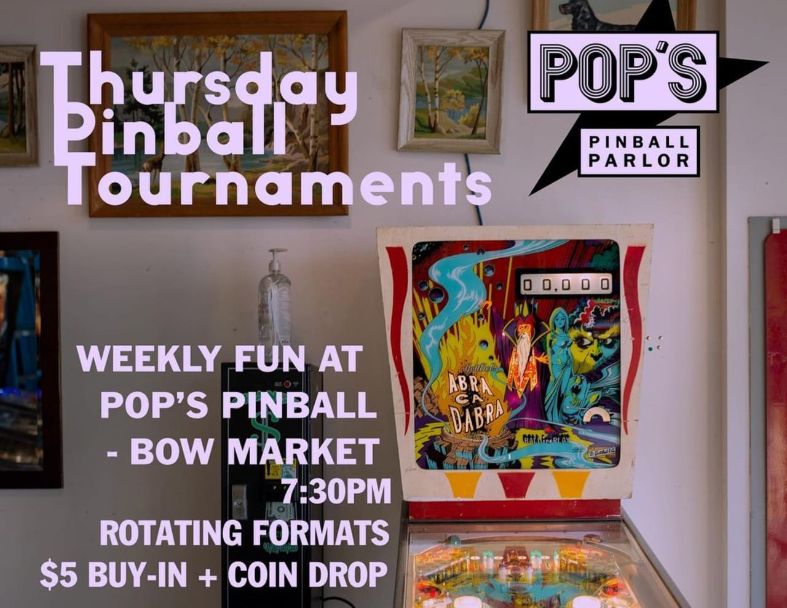
Foreshadowing a Future Hobby
Dragged my family to the Pinball Hall of Fame for my high school graduation celebration.
A few outings to Roxy’s Arcade in Cambridge, MA during college.
Going to Pop’s Pinball in Somerville, MA on my birthday then attending one of their casual tournaments.

Slide 7
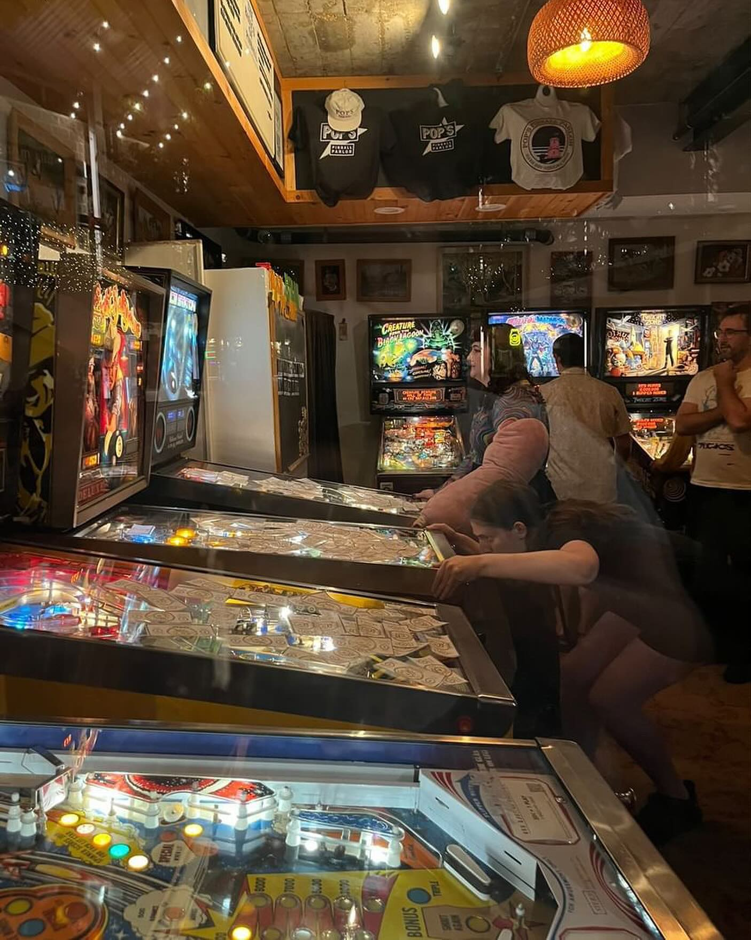
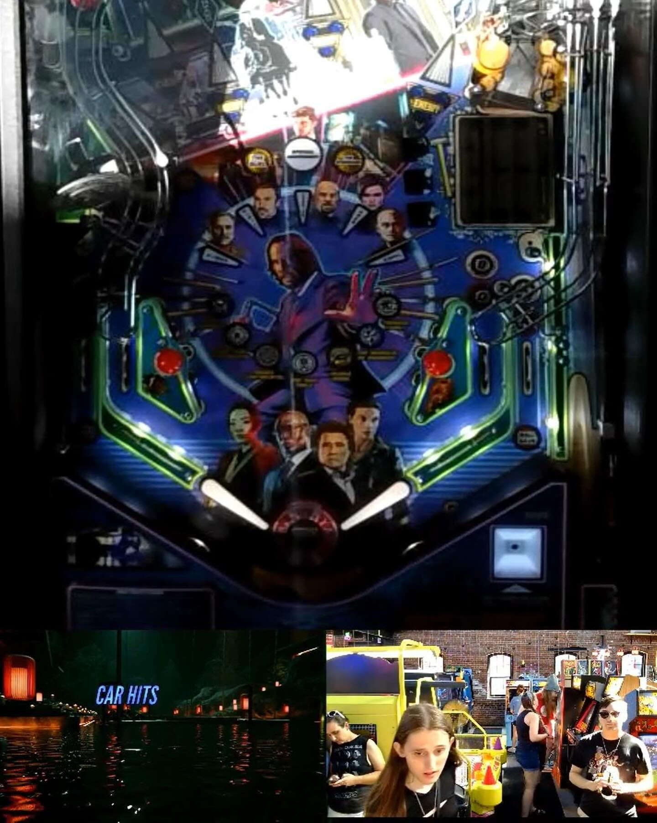
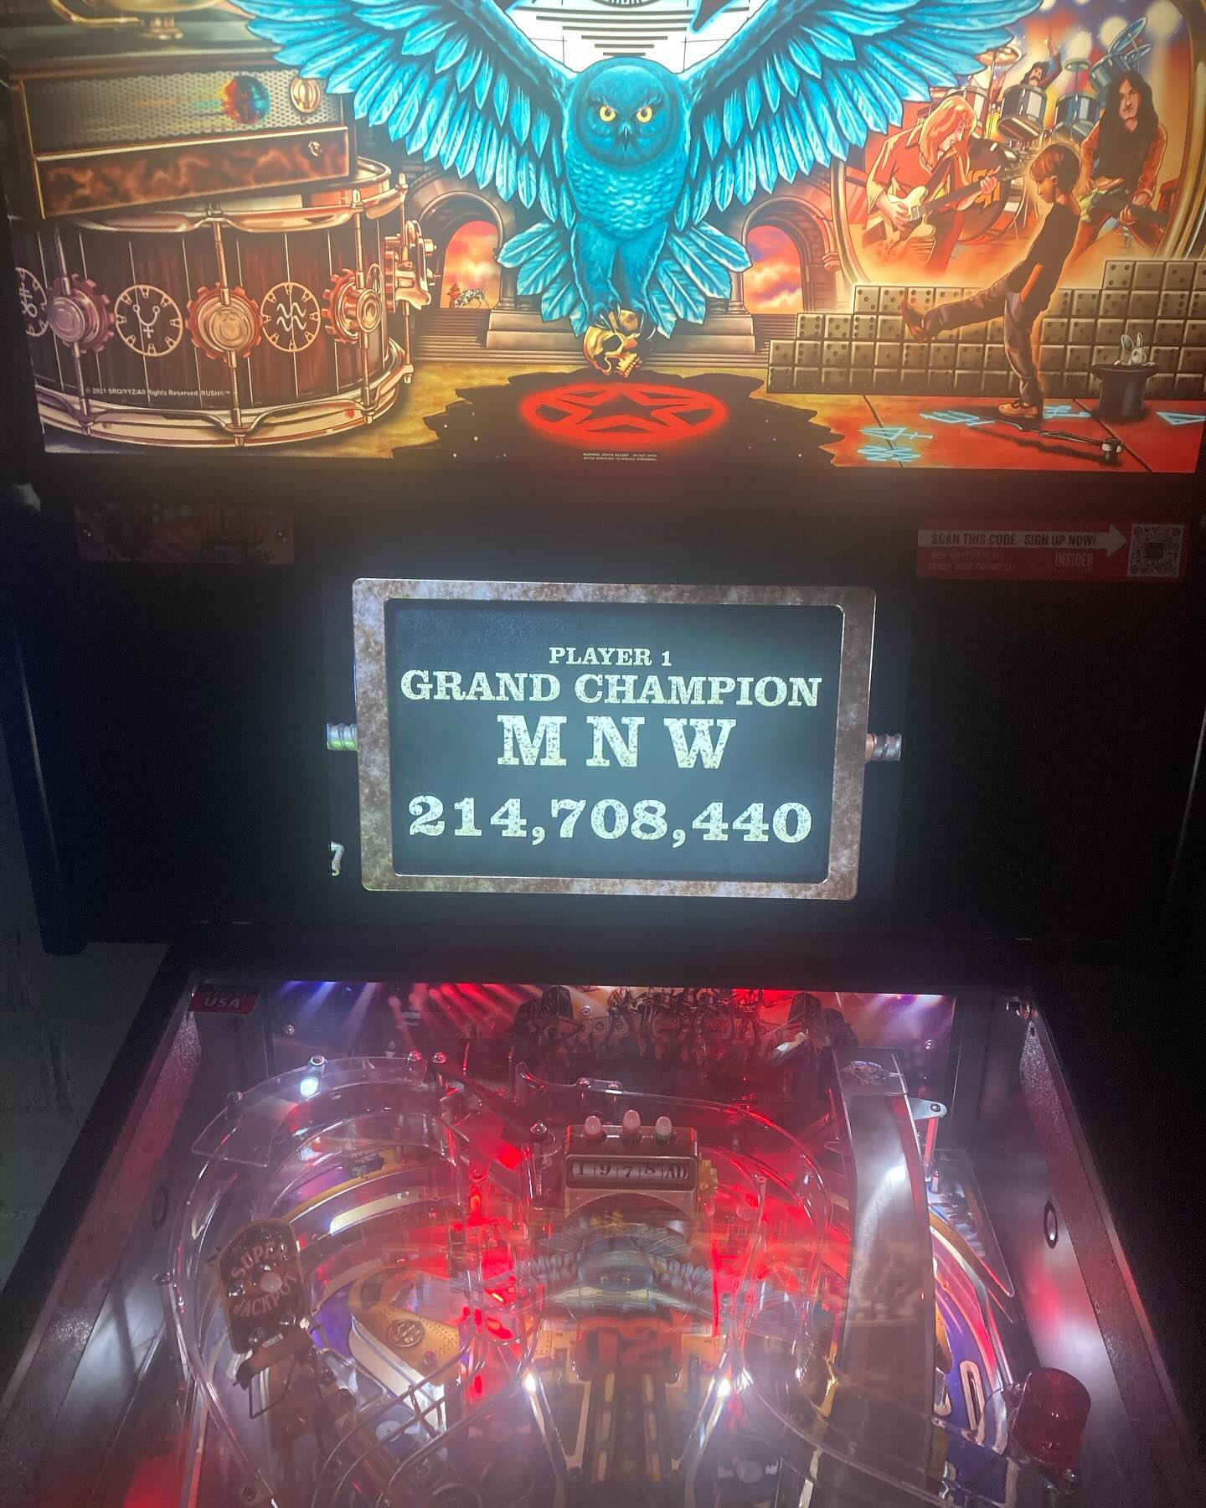
Today
An internationally ranked player*.
Competing in the New England Pinball League.
Regular at Pop’s Pinball, Roxy’s Arcade, and Hometown Arcade.
Dreaming of buying a pinball that I can totally get up three flights of stairs to our apartment.
* compete in one IFPA tournament and you will be too

Slide 8

Tour of typical gameplay
On “Medieval Madness” (Williams 1997)

Slide 9
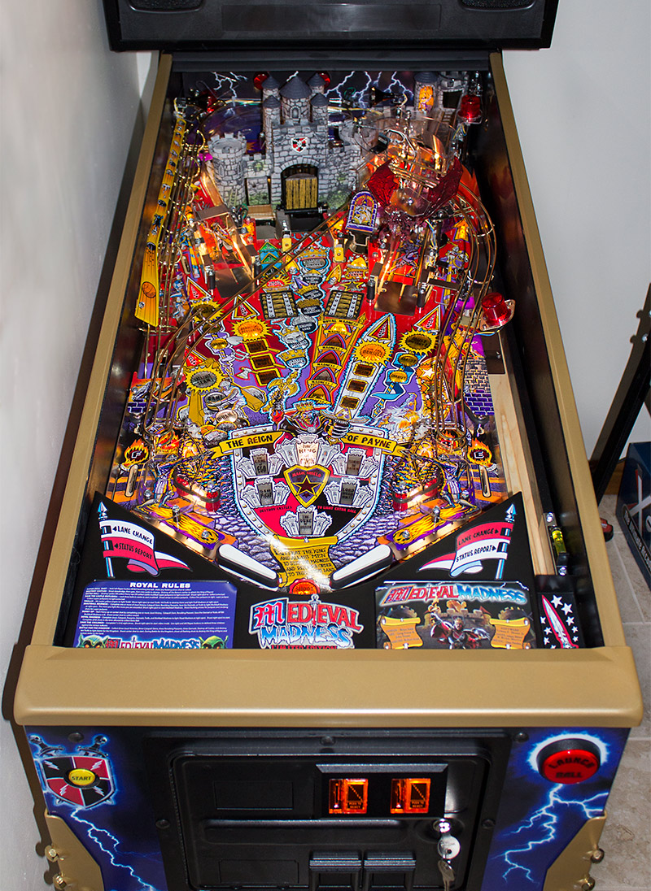
Plunge for Skill Shot
Skill Shot
Skill Shot
Hit plunge button and try to hit lighted lane above the pop bumpers.
Use flippers to change lighted lane at any time.
Super Skill Shot
Hold left flipper and plunge. Shoot any lit shot.
If shot is made quick enough, a hurry-up is started. Hit the castle quickly to score most points before time out.
Super Skill Shot
Plunge

Slide 10
Missions
Various objects of the playfield to reach a final goal.
Patron of Peasants – Left Ramp
Joust Champion – Left and Right Orbit
Catapult Ace – Far Left Outlet
Defender of Damsels – Right Ramp
Master of Trolls – Standup Targets and Pop-ups
Castle Crusher – Bash Target

Slide 11
Multiballs
Castle Multiball
Traditional three lock multiball.
Shoot ramps for jackpots.
Multiball Madness
Complete sub-missions then start multiball at the saucer.
Hit same shot as completed sub-missions for super jackpots.
Barnyard Multiball
Launch all five items with the catapult to start multiball
(Not sure what to do during it since I’ve never achieved it)

Slide 12
Side Activities
Video Mode
Roll over in-lanes to light FIRE eight times.
Hit saucer to start video mode on the dot matrix display
Mystery Award
Hit side standup targets to light saucer.
Land in saucer to collect Merlin’s Magic.
Bonus Multiplier
Light both top roll overs to increase your end-of-ball bonus multiplier.
Super Jets
Hit pop bumpers 50 times to score big points.
Royal Madness
Complete all five sub-missions to start challenge mode.

Slide 13
Wizard Mode
Complete all six missions.
Fight and defeat the King of Payne.
Tons of lit shots during the mode.

Slide 14
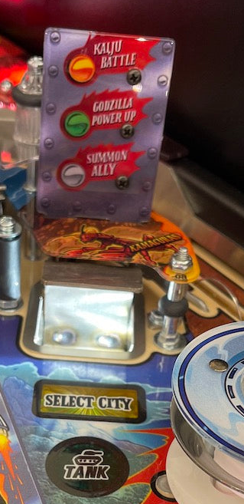
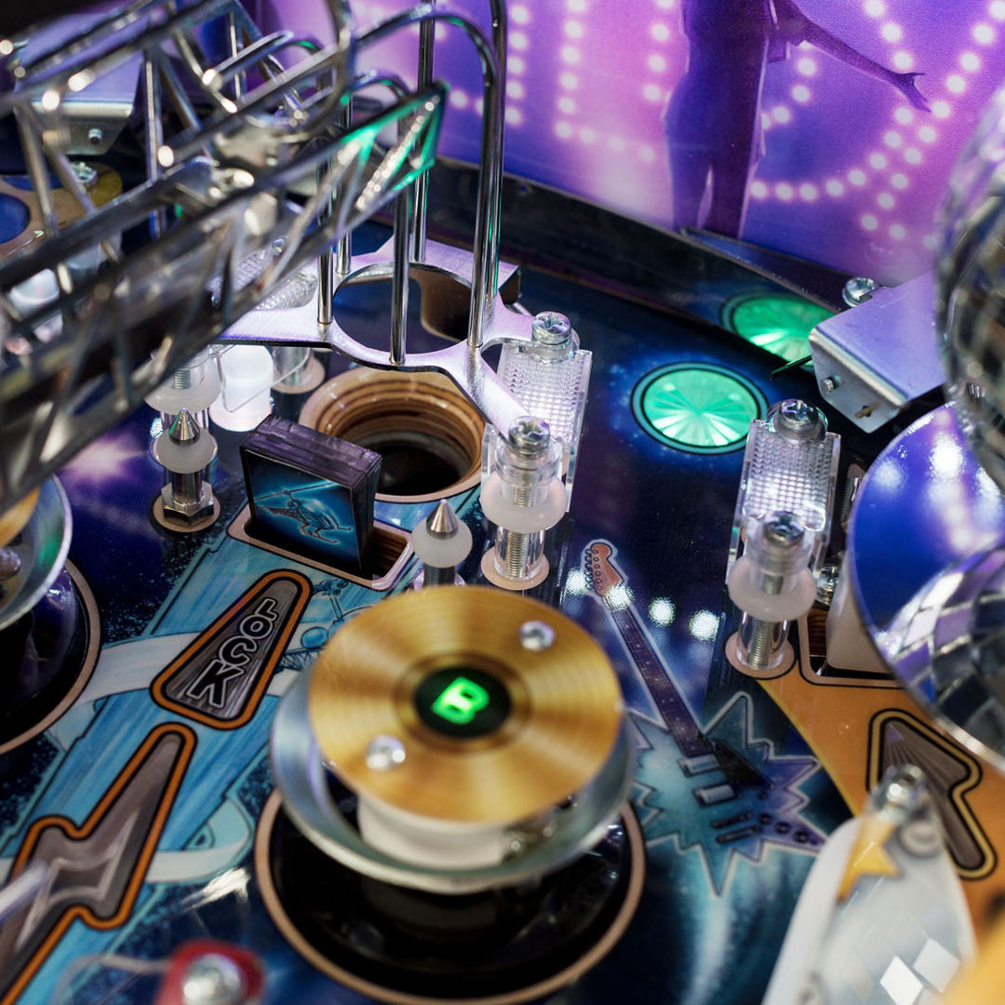
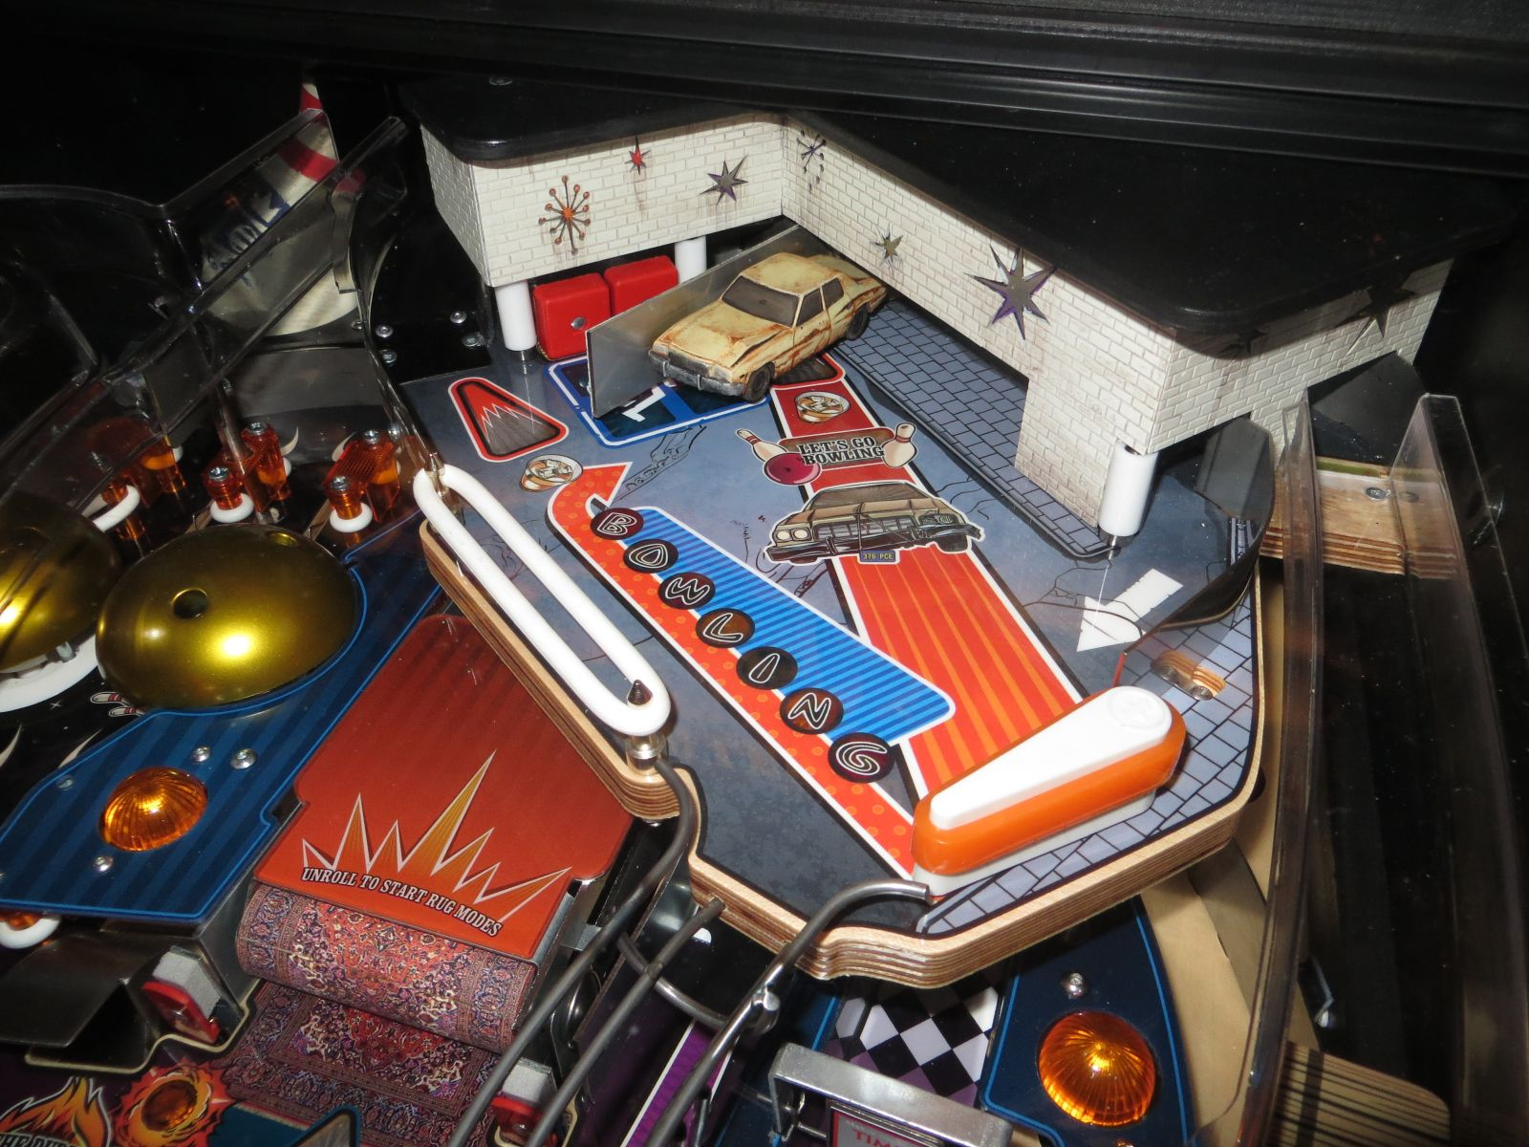
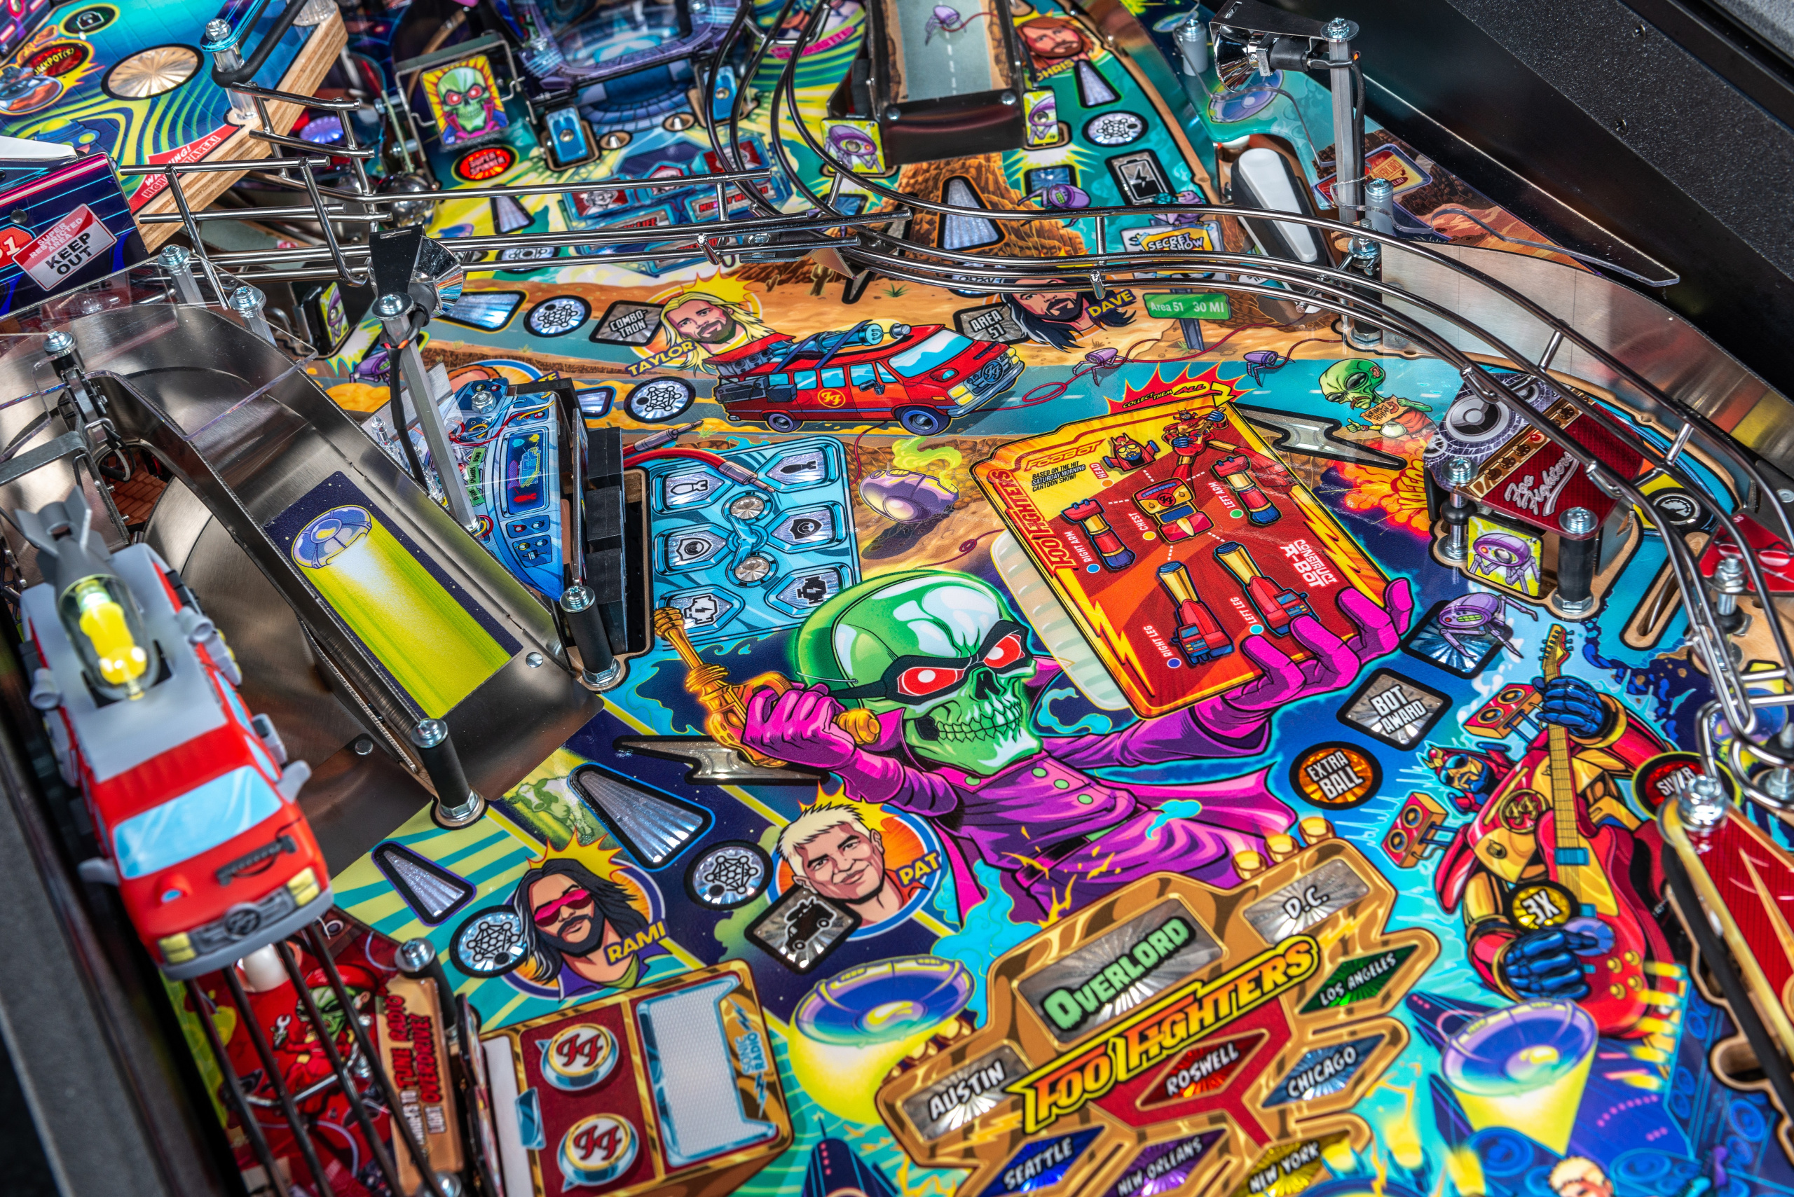
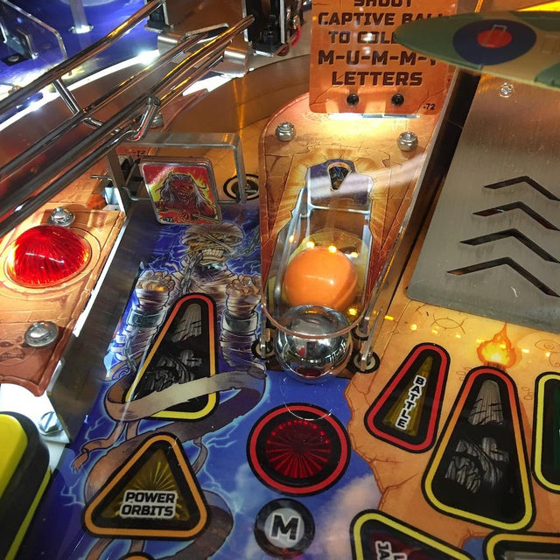
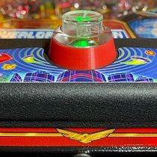
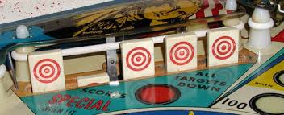
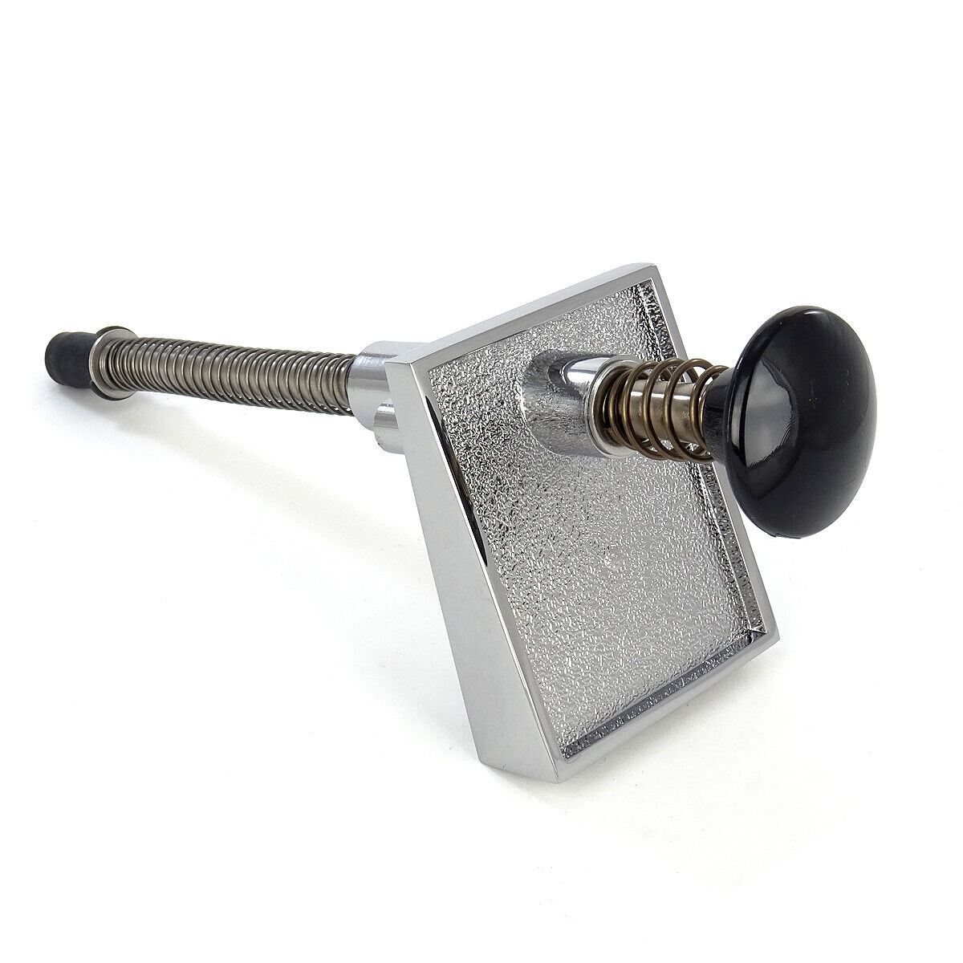
Other Pinball Features (not in Medieval Madness)
Cross Over Shots
Mini Playfield
Extra Flippers
Vertical Up Kicker
So many more mechs, toys, devices, sculpts, ramps, jumps, lanes, targets, and gimmicks.
Ball Scoop
Drop Targets
Captive Balls
Extra Buttons
Analog Plunger

Slide 15
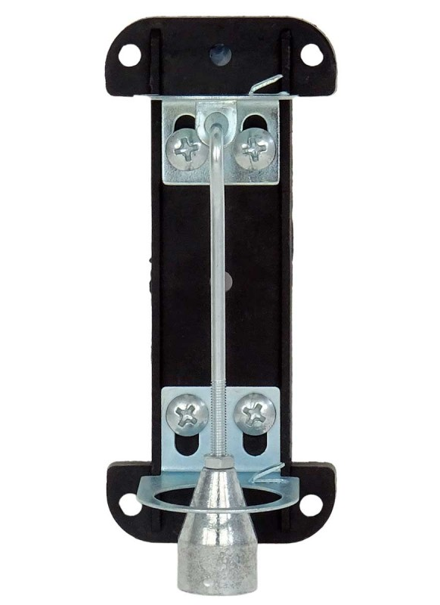
Tilt Bob
Limits how much you can nudge the game.
Punishes and deters you from dangerous moves.
Can be tightened or loosened to make the game stricter or more forgiving.
Gives two warnings and then issues a tilt which ends your current ball without any bonus multiplier.

Slide 16
History and Evolution
Rise and fall of so many manufacturers

Slide 17
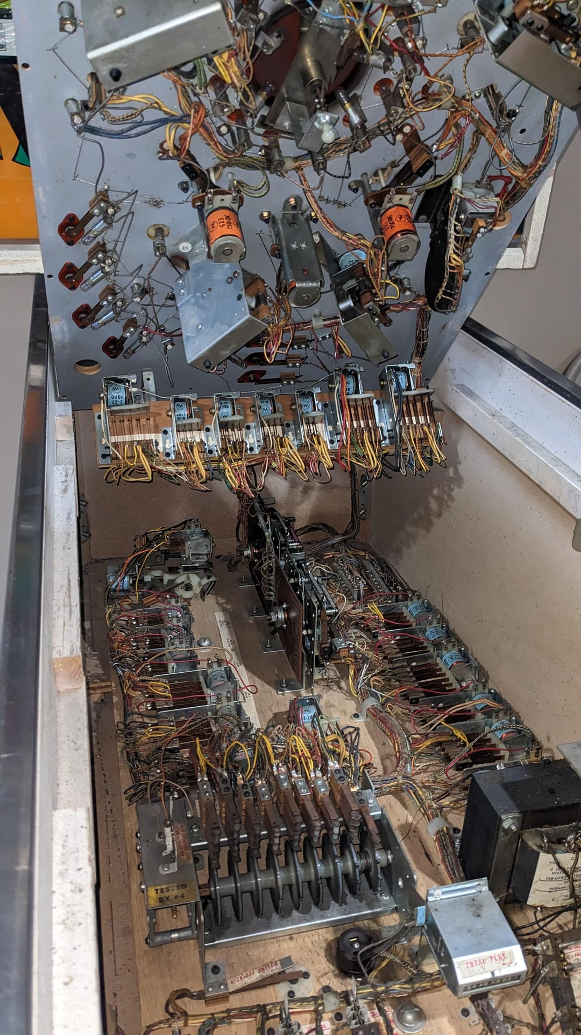

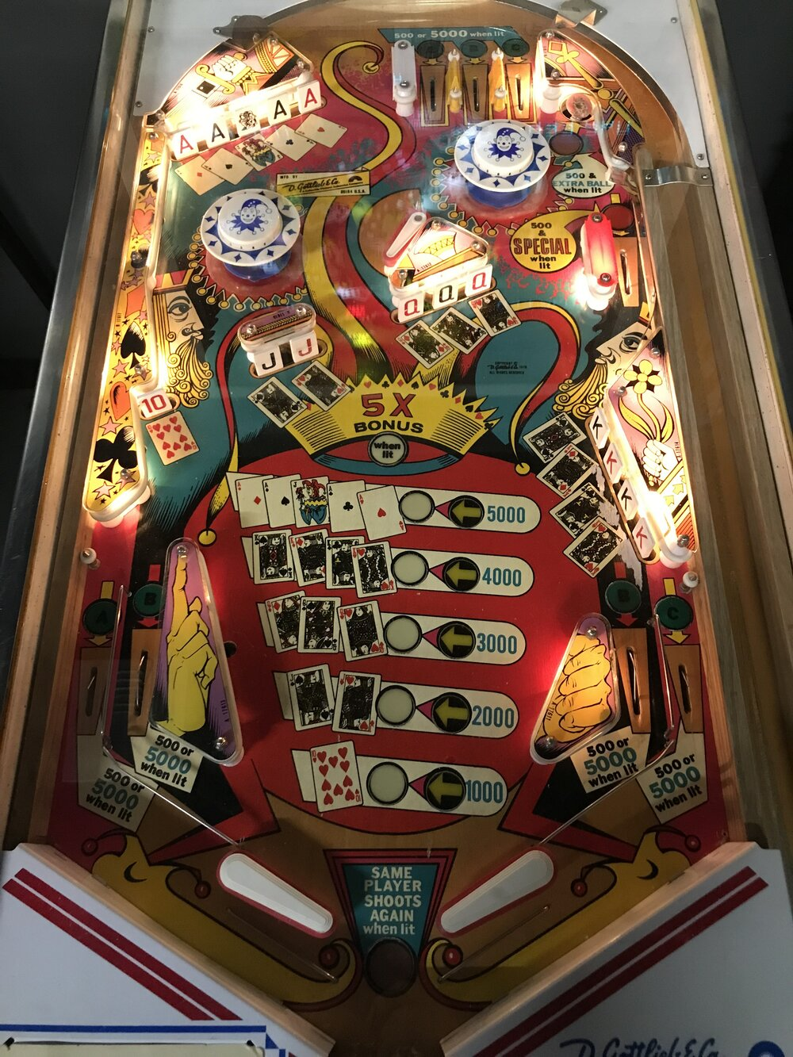
Electro-Mechanical
All physical circuits and switches.
Score reals.
Bells and thumpers.
No semiconductors (or maybe a very small few).
Simple rules due to limits of circuit logic.

Slide 18
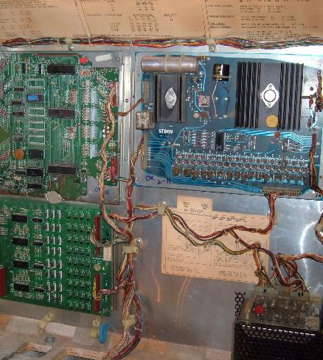
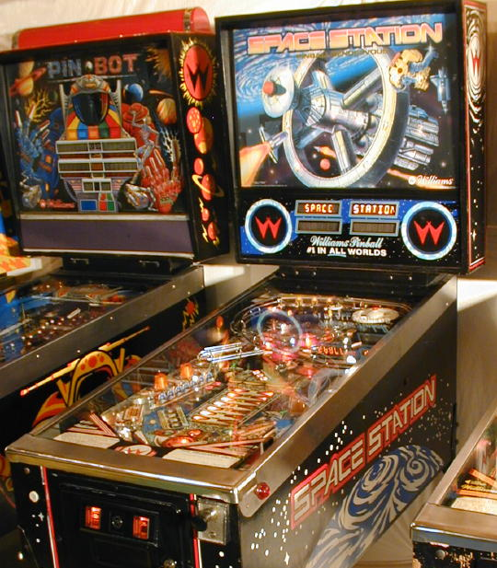
Solid State
Semiconductors, software, and digital number displays.
Increasing complexity of rules.
Increased targets and mechs in games.
Eventually added speakers for music, sound effects, and voices.

Slide 19
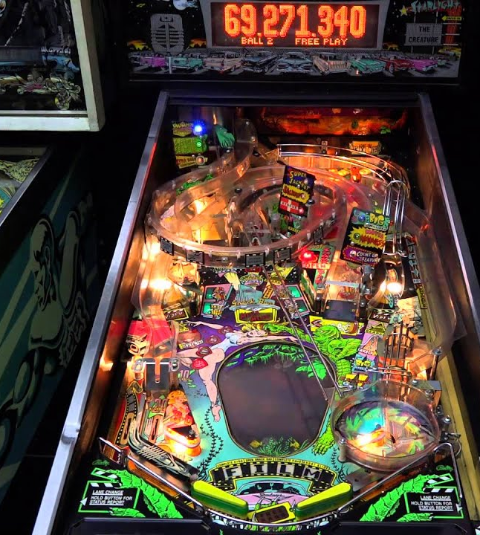
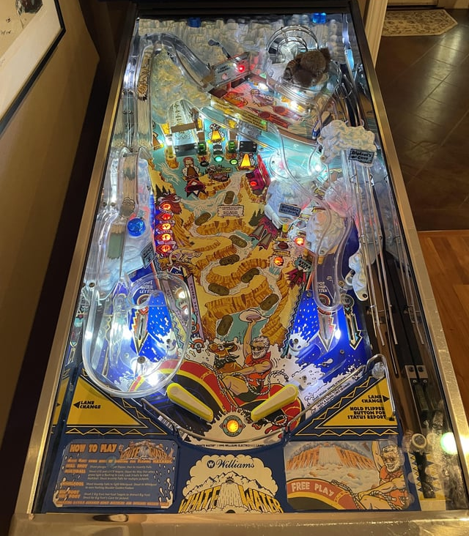
Dot Matrix Display
Technically still a solid-state pinball.
Major advances in software and game complexity.
Deaths of major manufacturers: Williams, Bally, and Gottlieb.

Slide 20
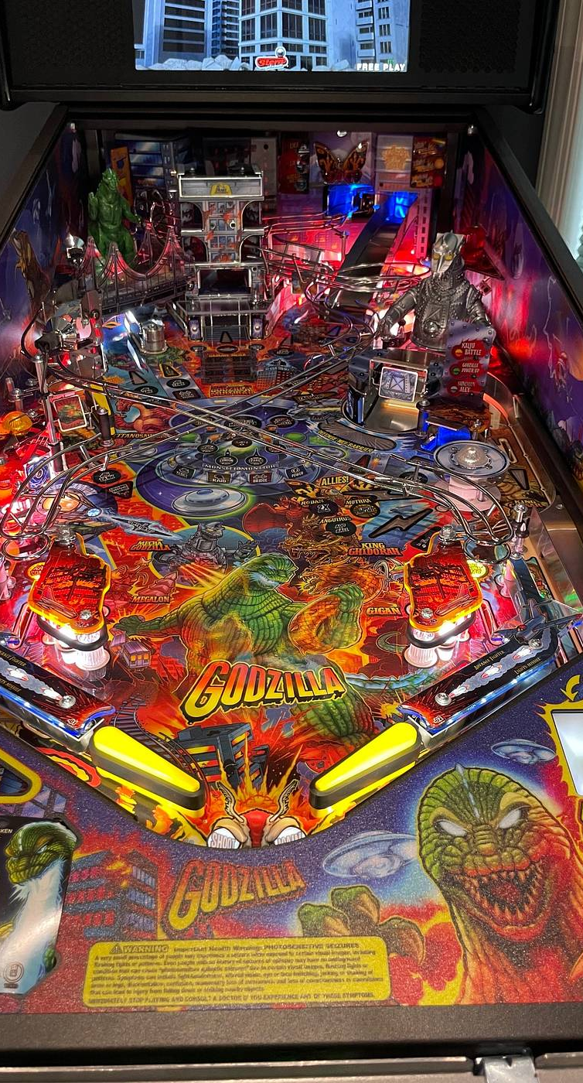
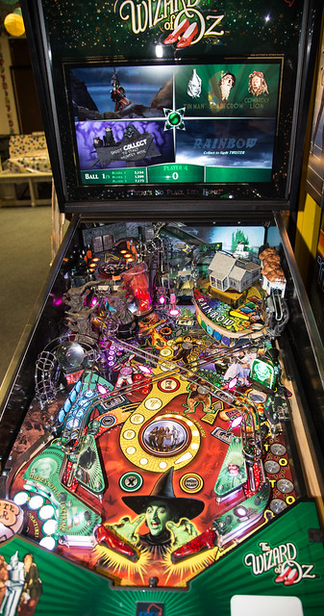
LCD
Modern games with advanced software and deep rulesets.
Video playing constantly throughout the game.
Cut back on physical devices for sounds.

Slide 21
Tips and Tricks
Useful knowledge for causal playing.

Slide 22
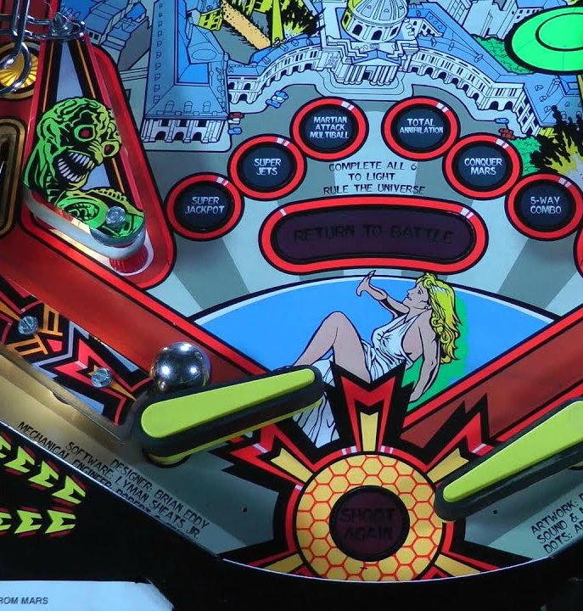
Cradle the Ball
Hold flipper up so that the ball rests on the joint.
Take a break, drink something, calm down after action, reassess the situation.
Newer games will display quick info that you can scroll through using the non-cradling flipper.

Slide 23
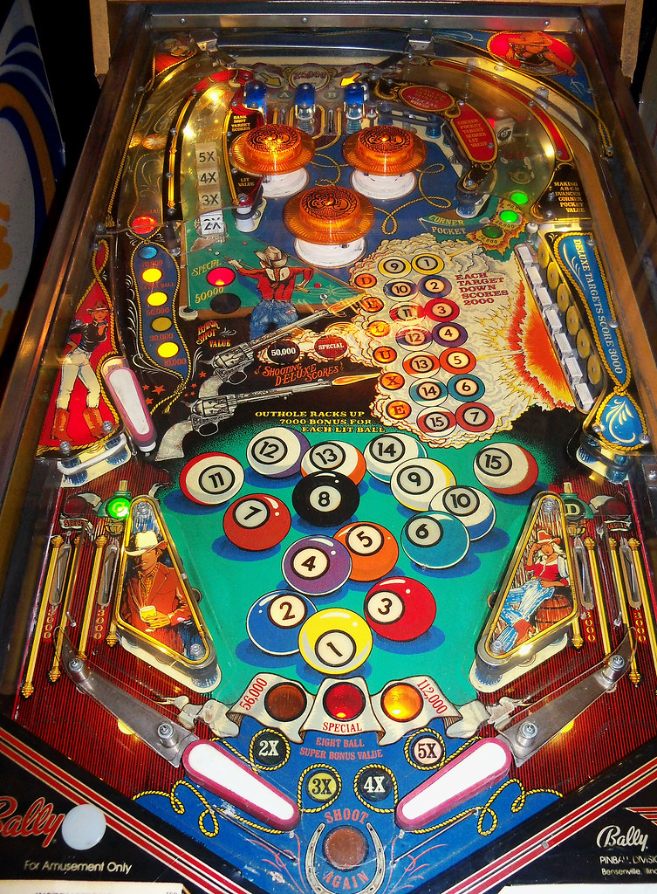
Backhand shots
Keep ball on same side of field as the flipper.
Shoot earlier on the flipper so ball goes upward more than sideways.
Tends to be safer since the ball goes slower.

Slide 24
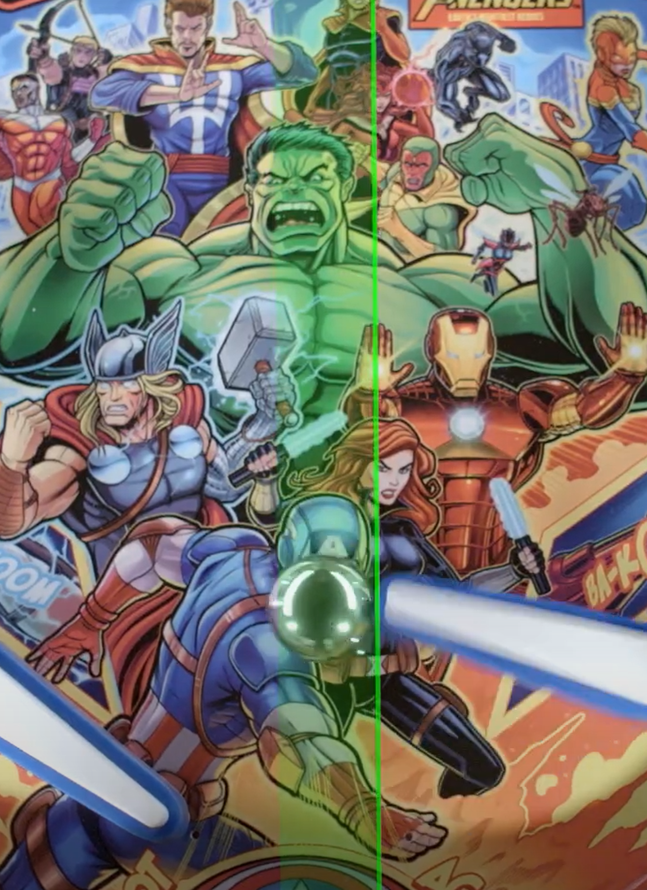
Slap Save
Technique for when a ball appears to be going straight down the middle.
Slap one side and flipper button hard.
Extends the reach of the flipper by moving the playfield underneath the ball.
Immediately follow it with a slap to the other side and flipper button.
Attempts to balance out impact to the tilt bob.
Launches the ball upward and away from the drain if the first flip didn’t send it away.

Slide 25
ADVANCED TECHNIQUES
Woah, these will definitely be super difficult!!!

Slide 26
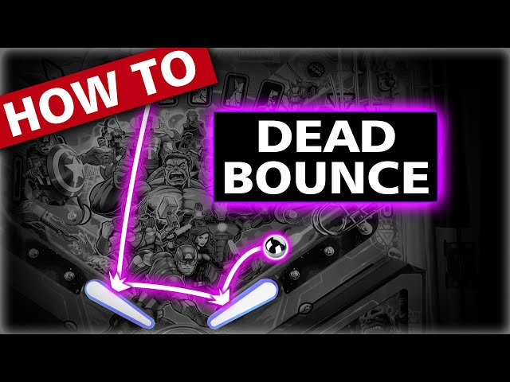
Dead Bounce
Let the ball hit the flipper without flipping so that it bounces to the other flipper.
Make sure the trajectory is safe to perform this.
Too steep with the flipper angle might drain.
Hitting the metal of the in-lane will launch the ball out of control.
Can usually catch the ball on the other side for a cradle.

Slide 27
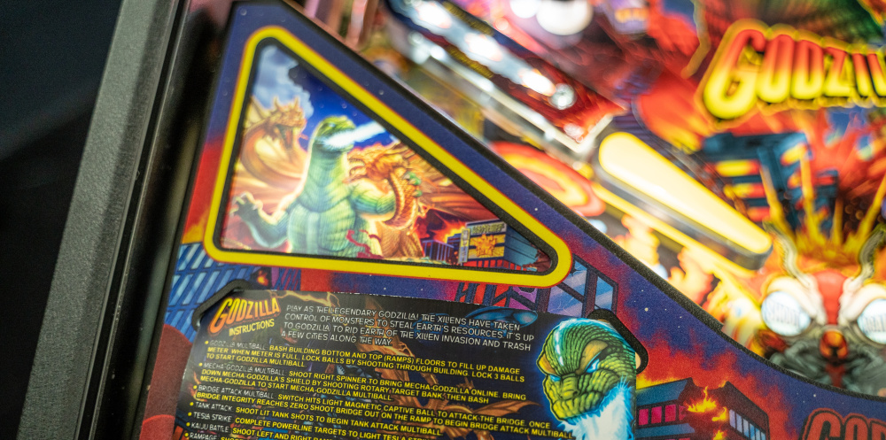
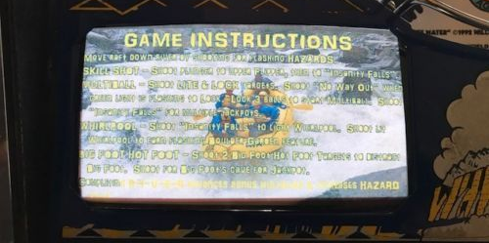
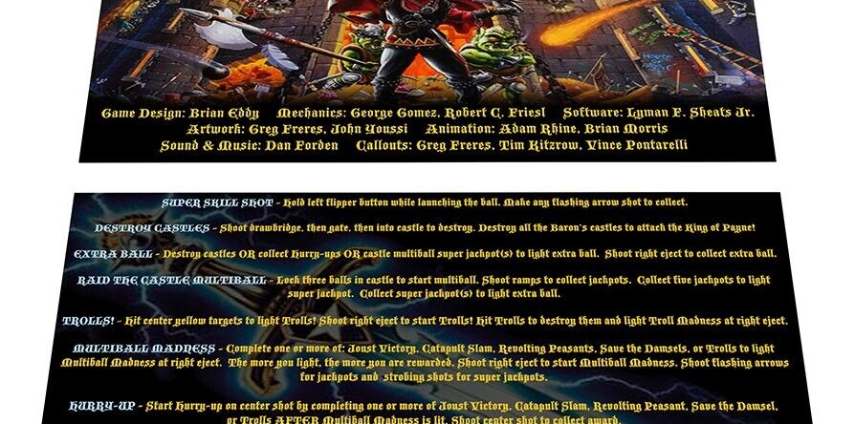
Read the Instructions
There is usually a cut-out in the bottom left with the abridged instructions.

Slide 28
Getting Involved
From finding an arcade to joining tournaments

Slide 29
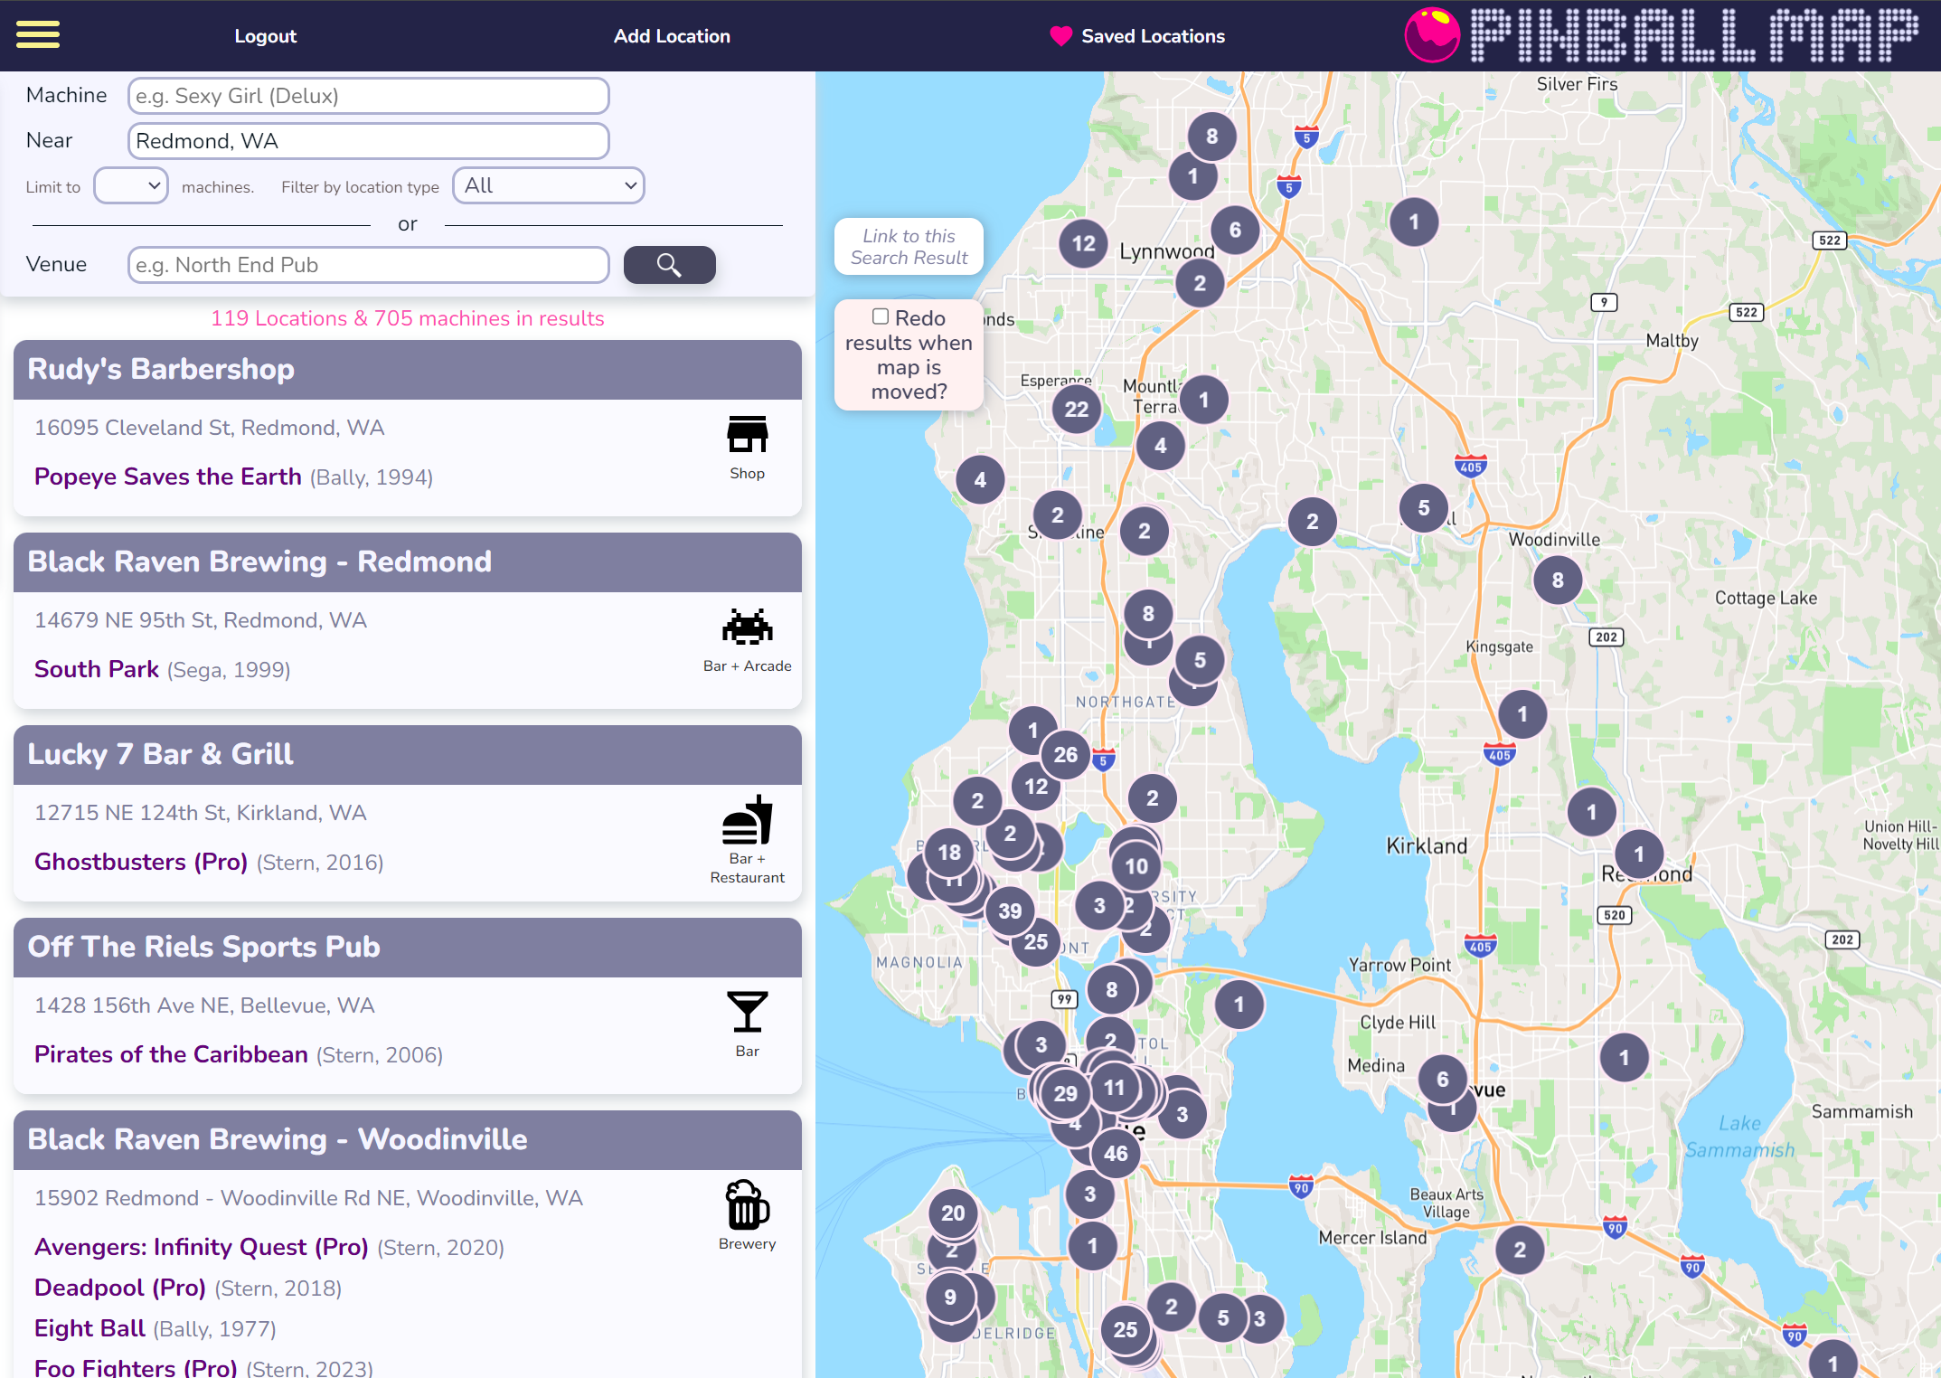
Finding a Location
Check out the Pinball Map.
An open-source app and website documenting pinball locations.
Check the comments to see if the pins are well maintained.
Try to find a free-play location if you can.
One price to enter rather than pay per game.
As you improve, pay per game can become more cost efficient.

Slide 30
Finding Events
Leagues host recurring tournaments.
Locations might have one off or recurring tournaments.
Not all tournaments are serious (see photo for proof).
Most events will have a wide range of skill levels attending.
Find events on Match Play or the IFPA website.

Slide 31
Resources
Maps
Pinball Map – pinballmap.com/map
Tournaments
Match Play – app.matchplay.events/events
International Flipper Pinball Association – https://www.ifpapinball.com/calendar
Leagues
New England Pinball League – nepl.org
Seattle Pinball League – splpinball.com
Videos
Abe Flips – Pinball Skill Videos
PAPApinball – www.youtube.com/@PAPApinball

Slide 32

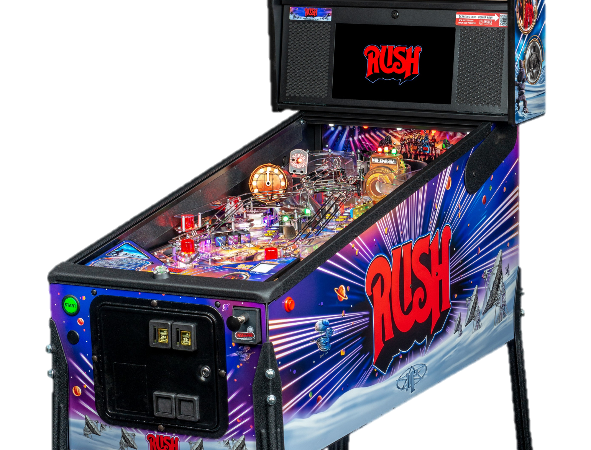
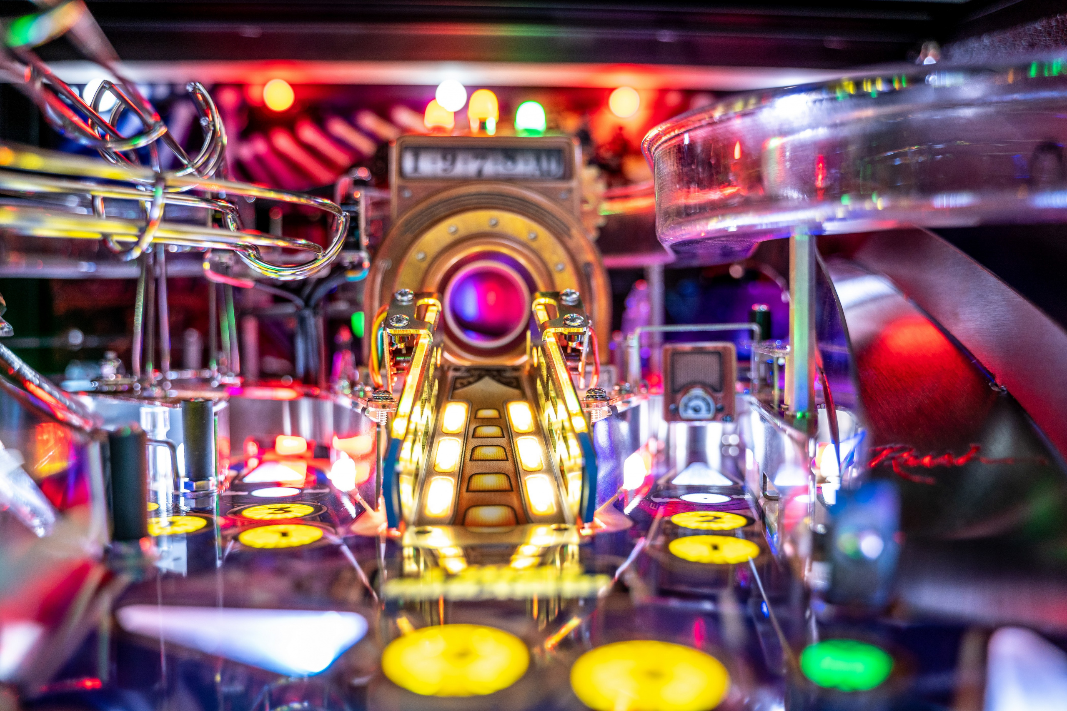
My Favorite Pin Rush
A favorite band of mine since I was young.
Fun with deep rules and incredible theme integration.
A band pin with callouts from the actual band members.

Slide 33

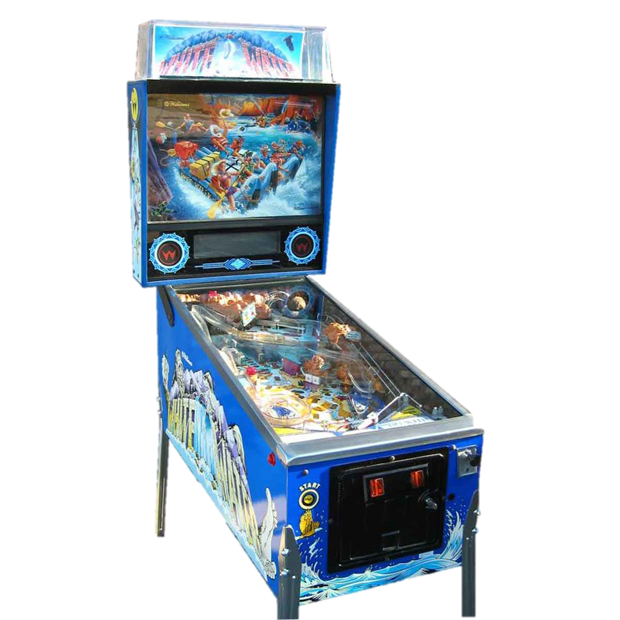
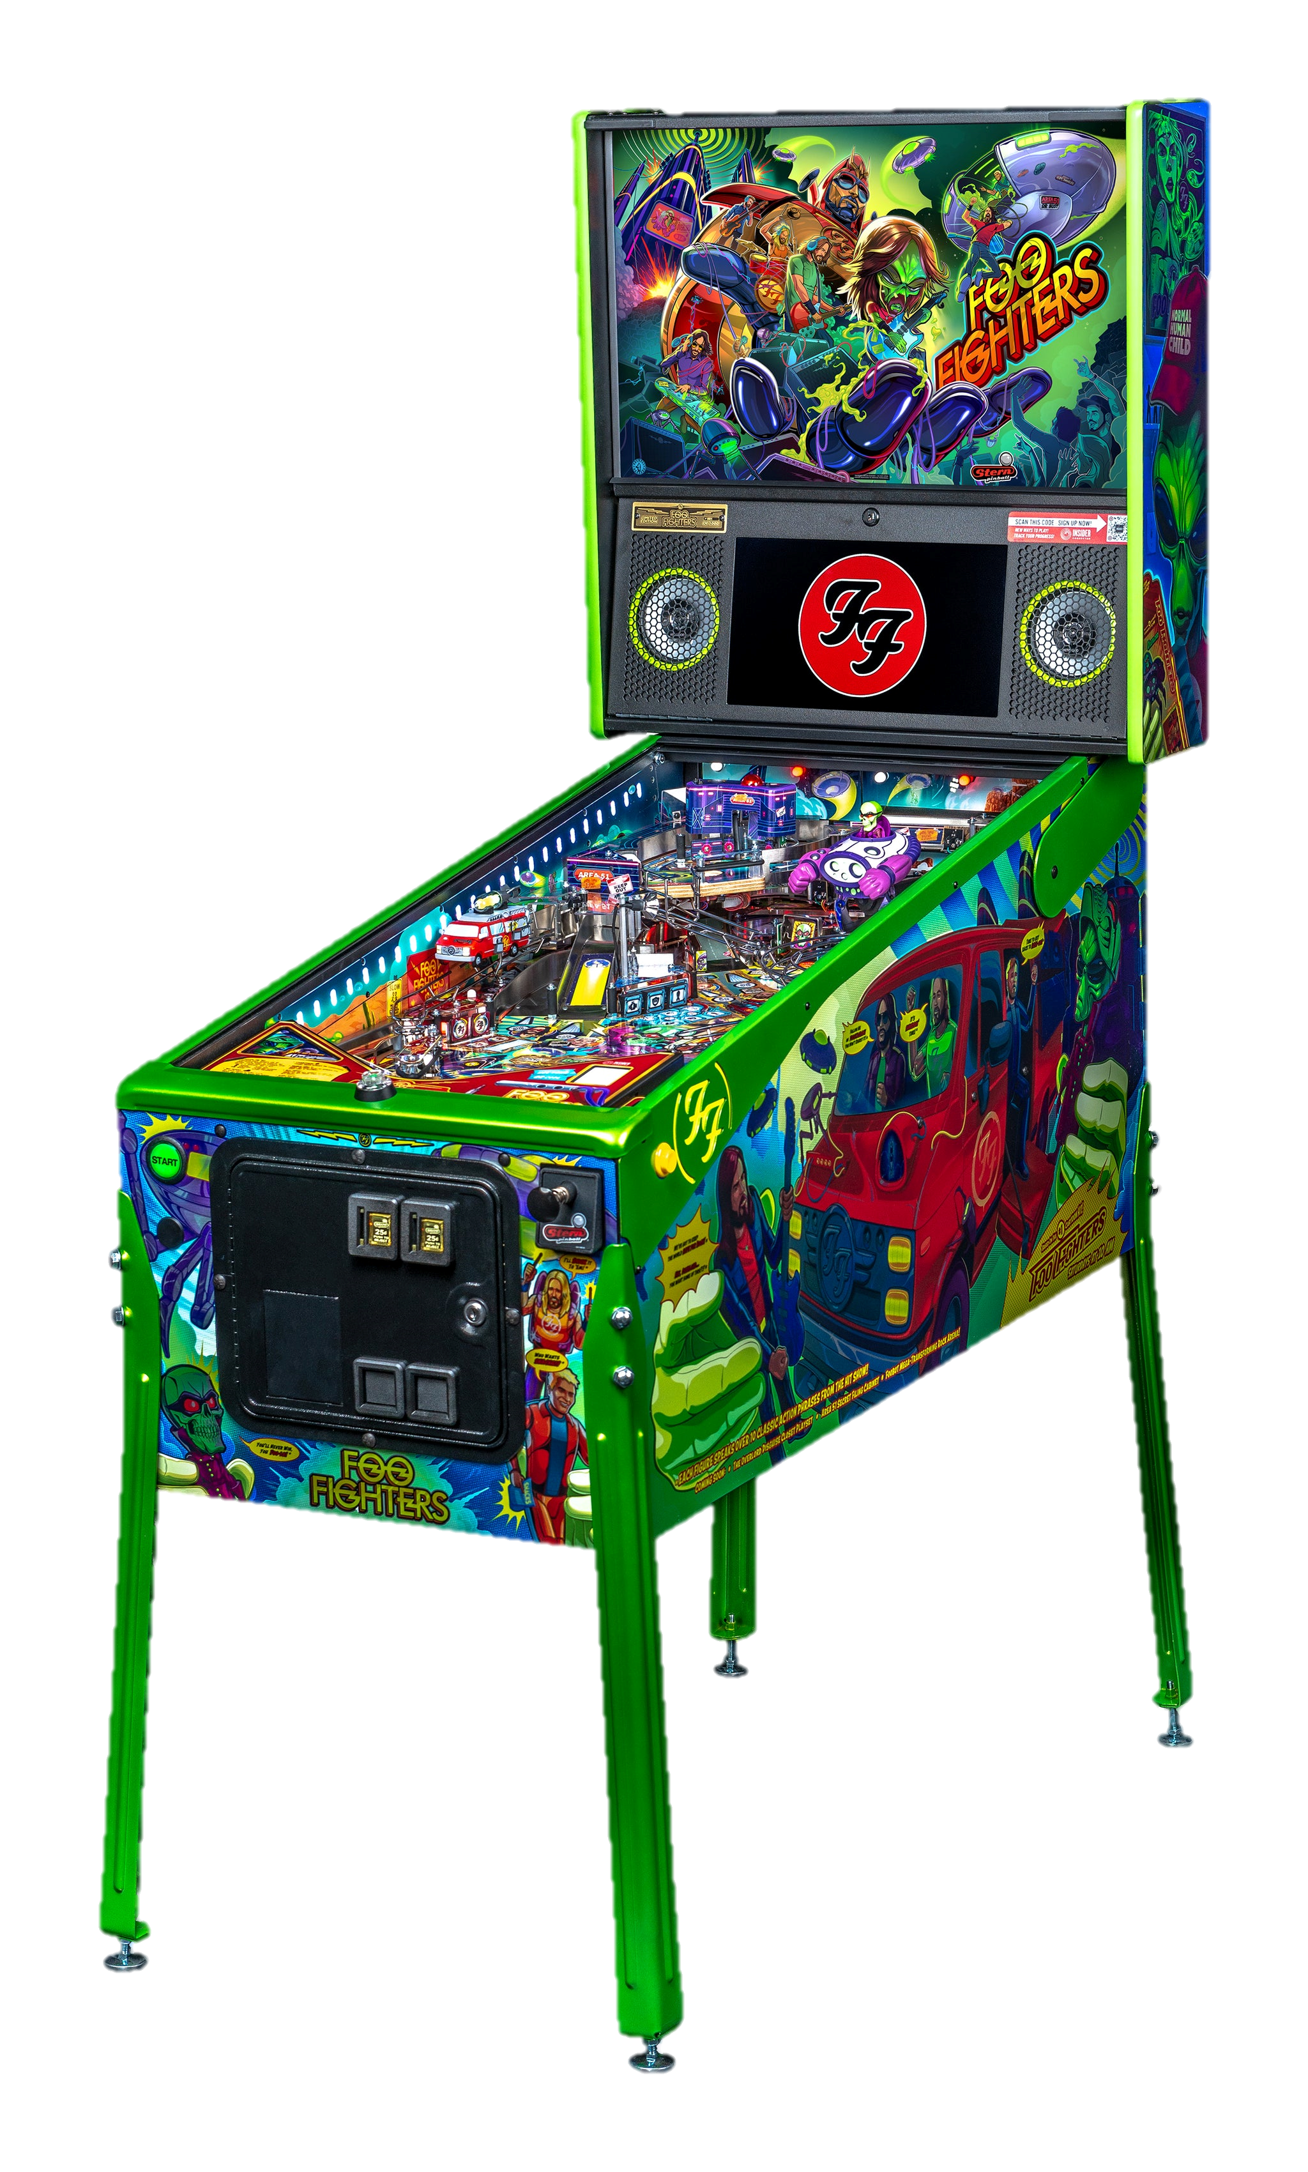
Other Favorites

